Slide 1
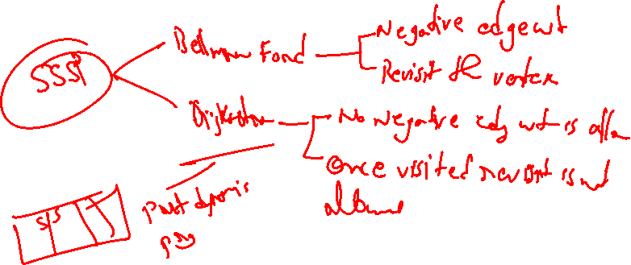
Designing and Analysis of Algorithms Course Code: ECS 5101/CS514
Dr Rahul Mishra
IIT Patna
Lecture 25

Slide 2
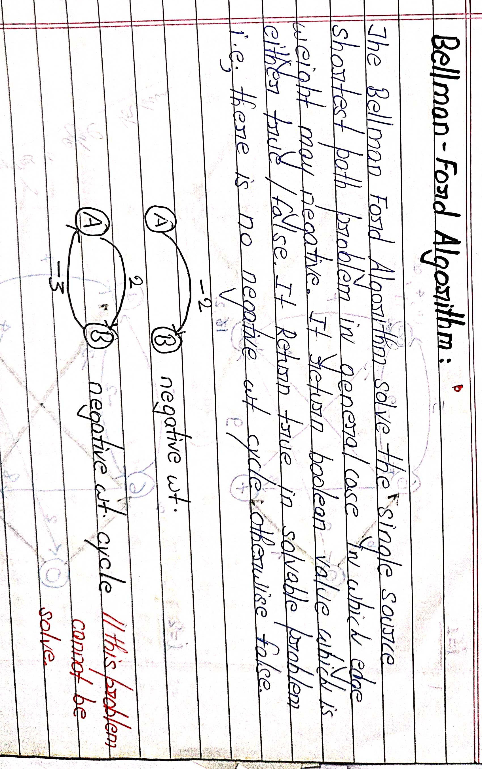

Slide 3
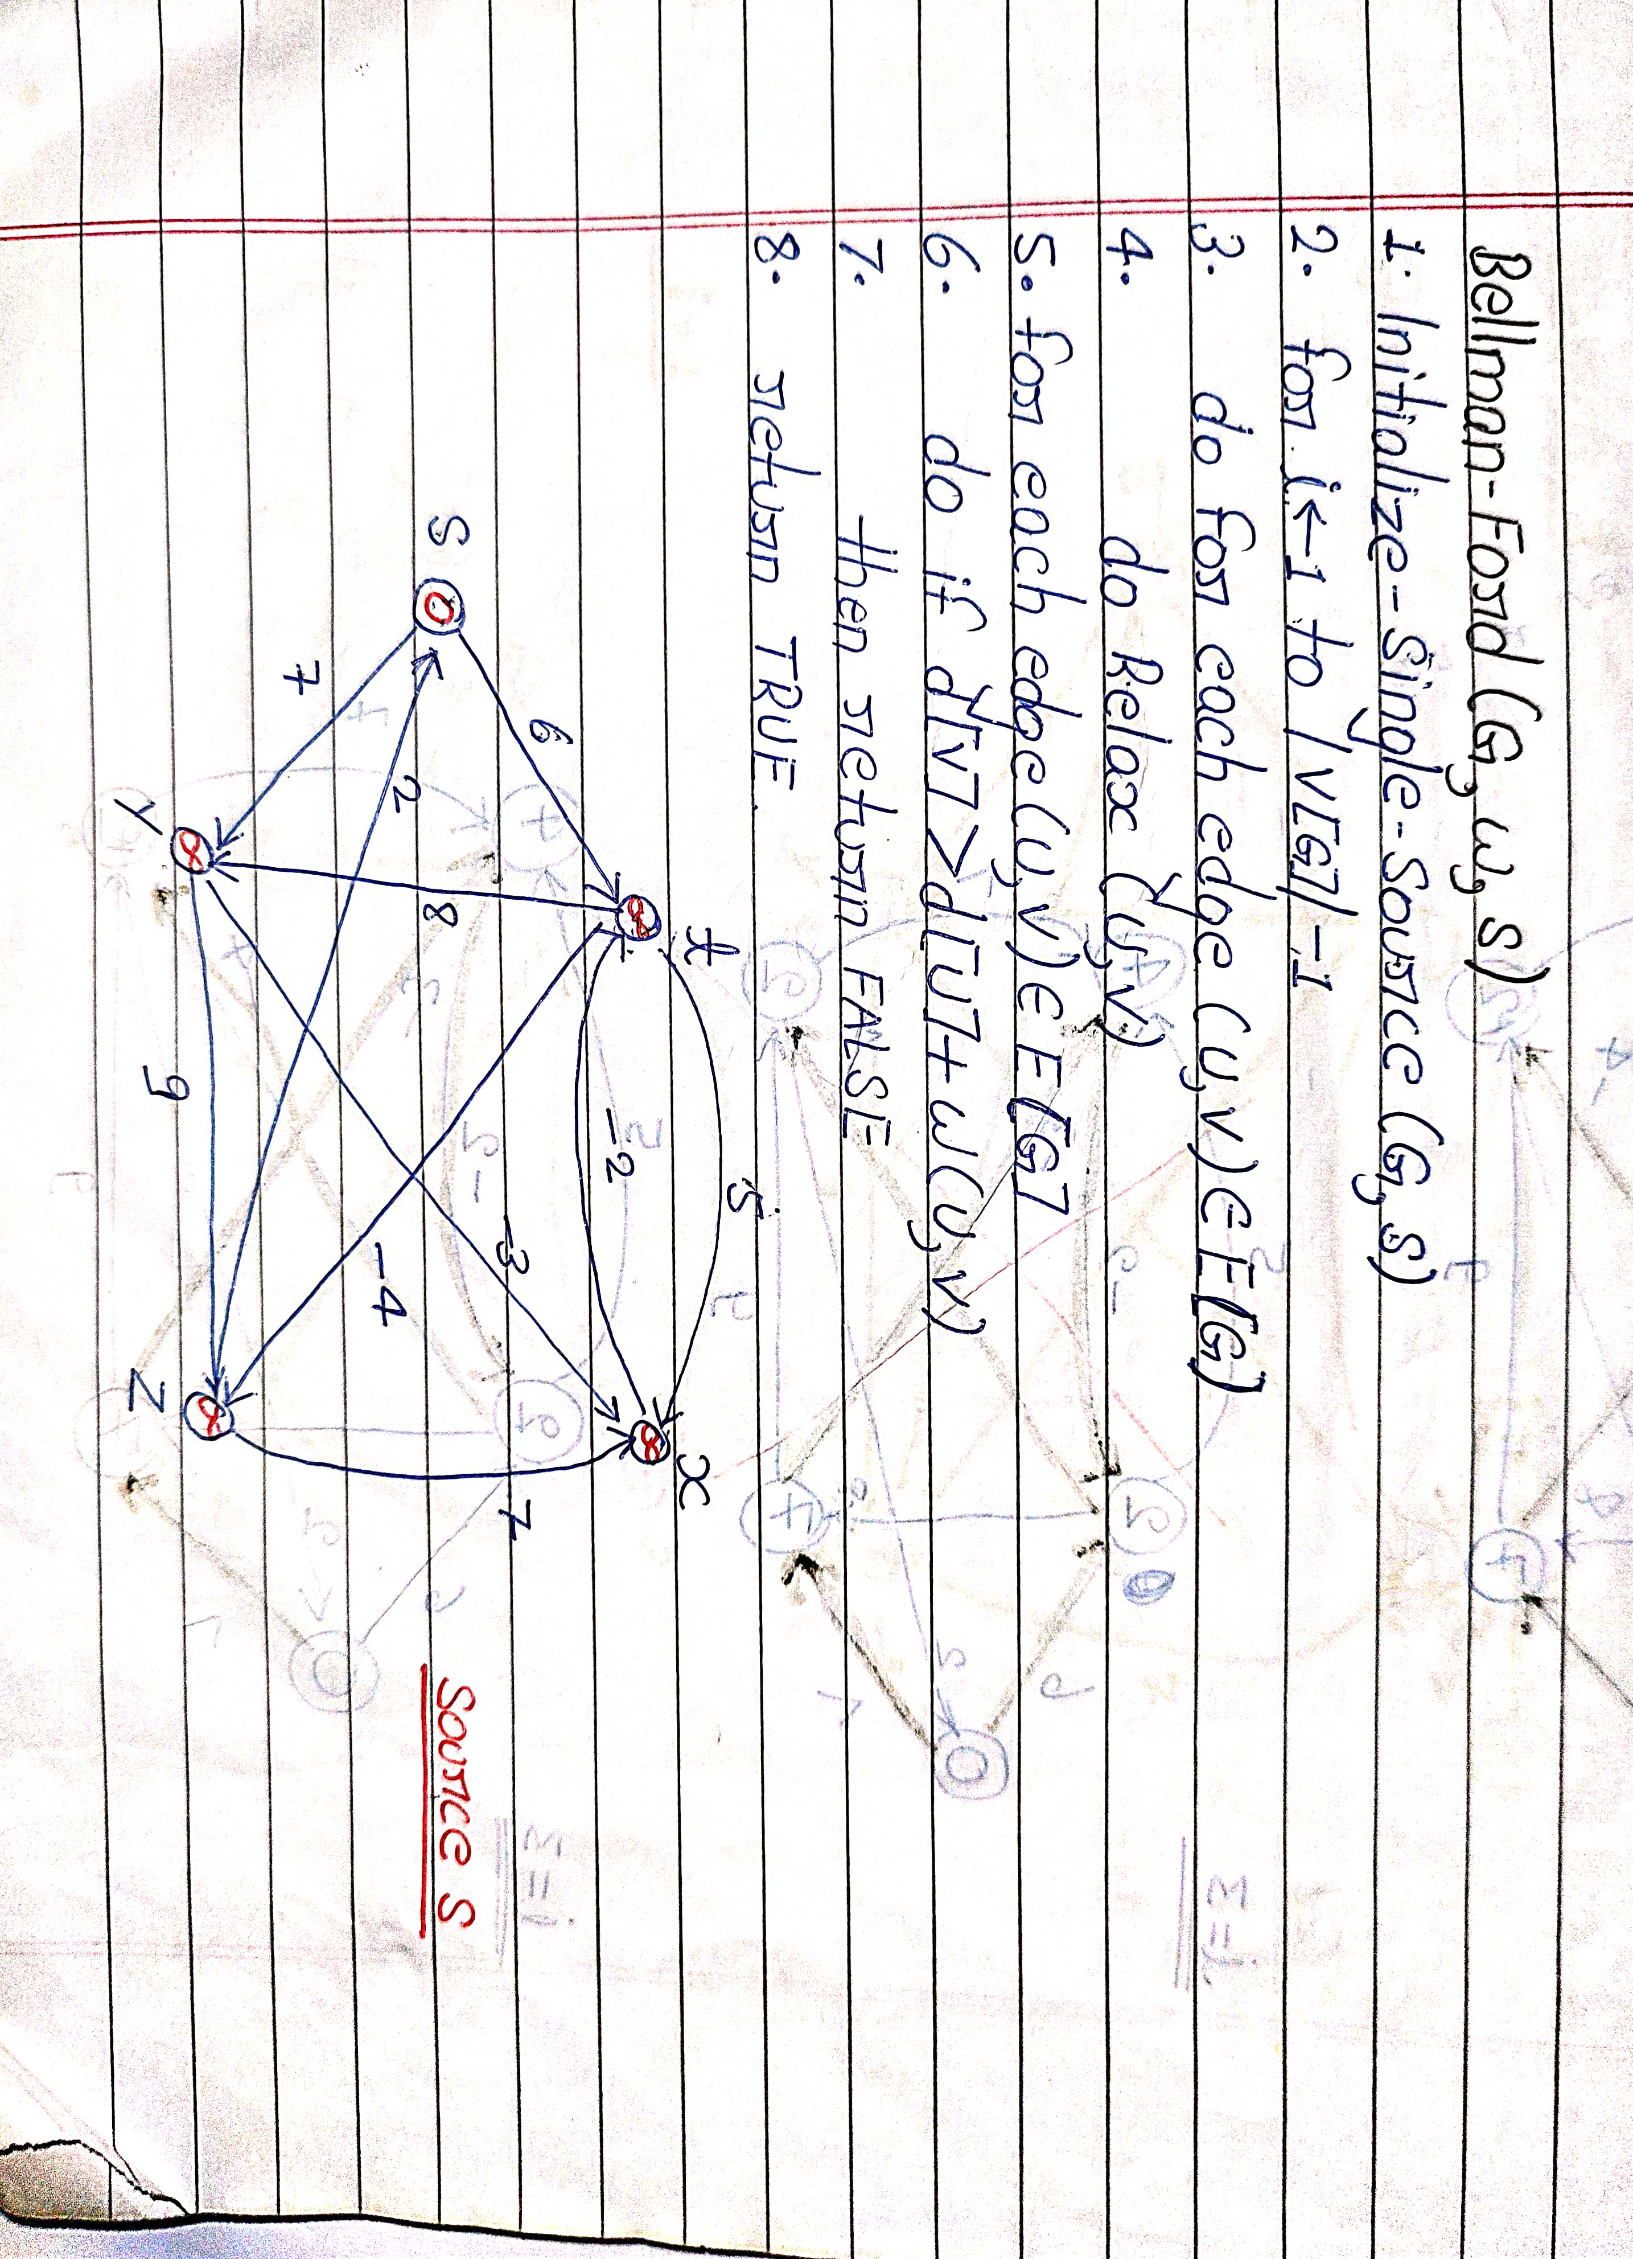

Slide 4
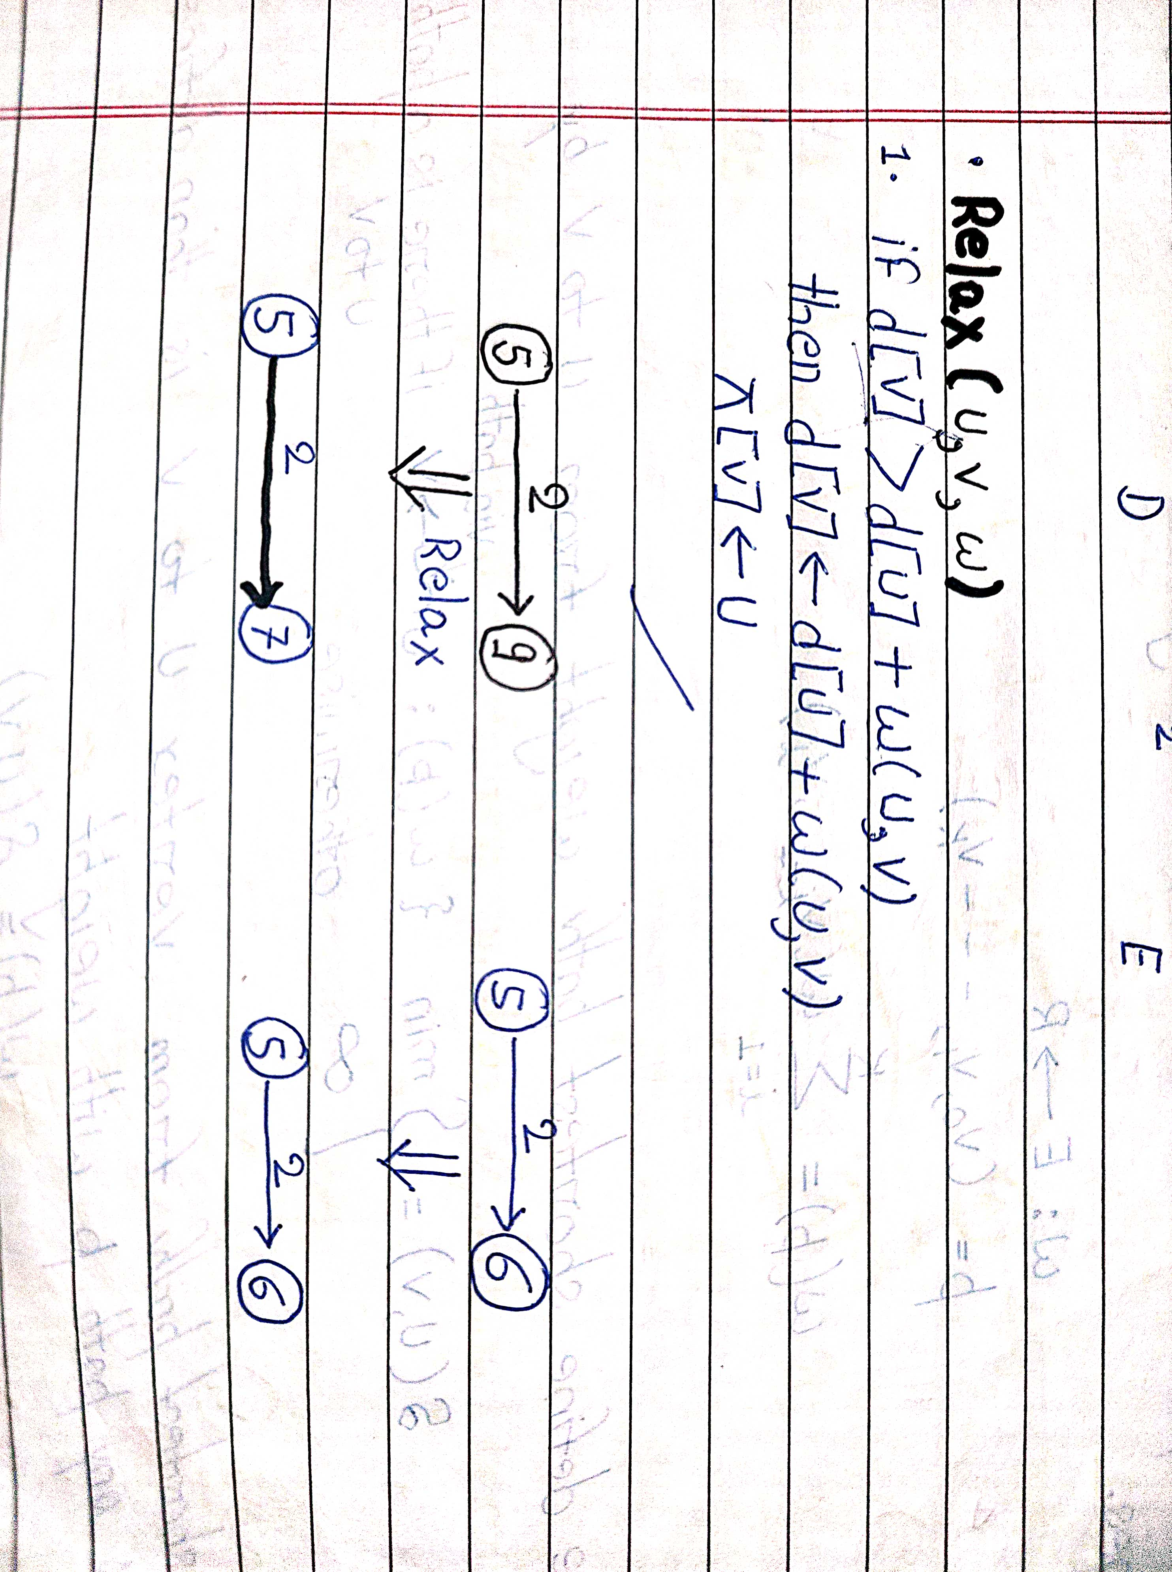


Slide 5
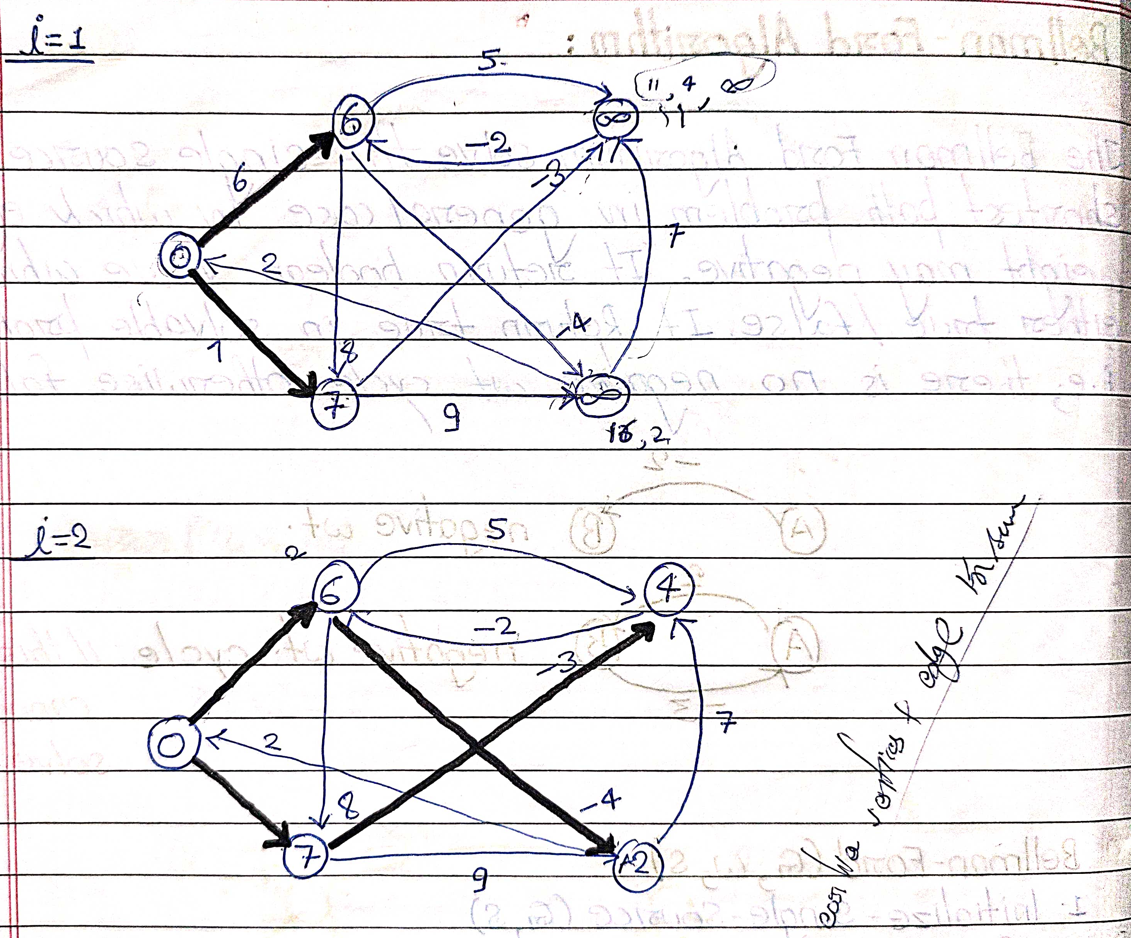

Slide 6
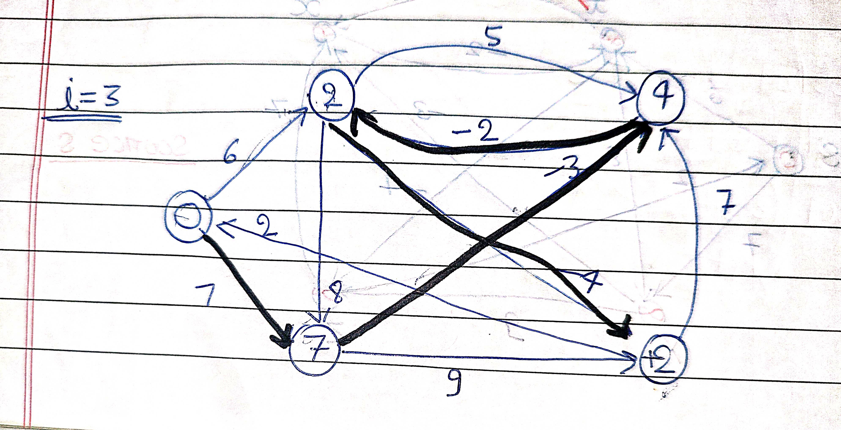

Slide 7
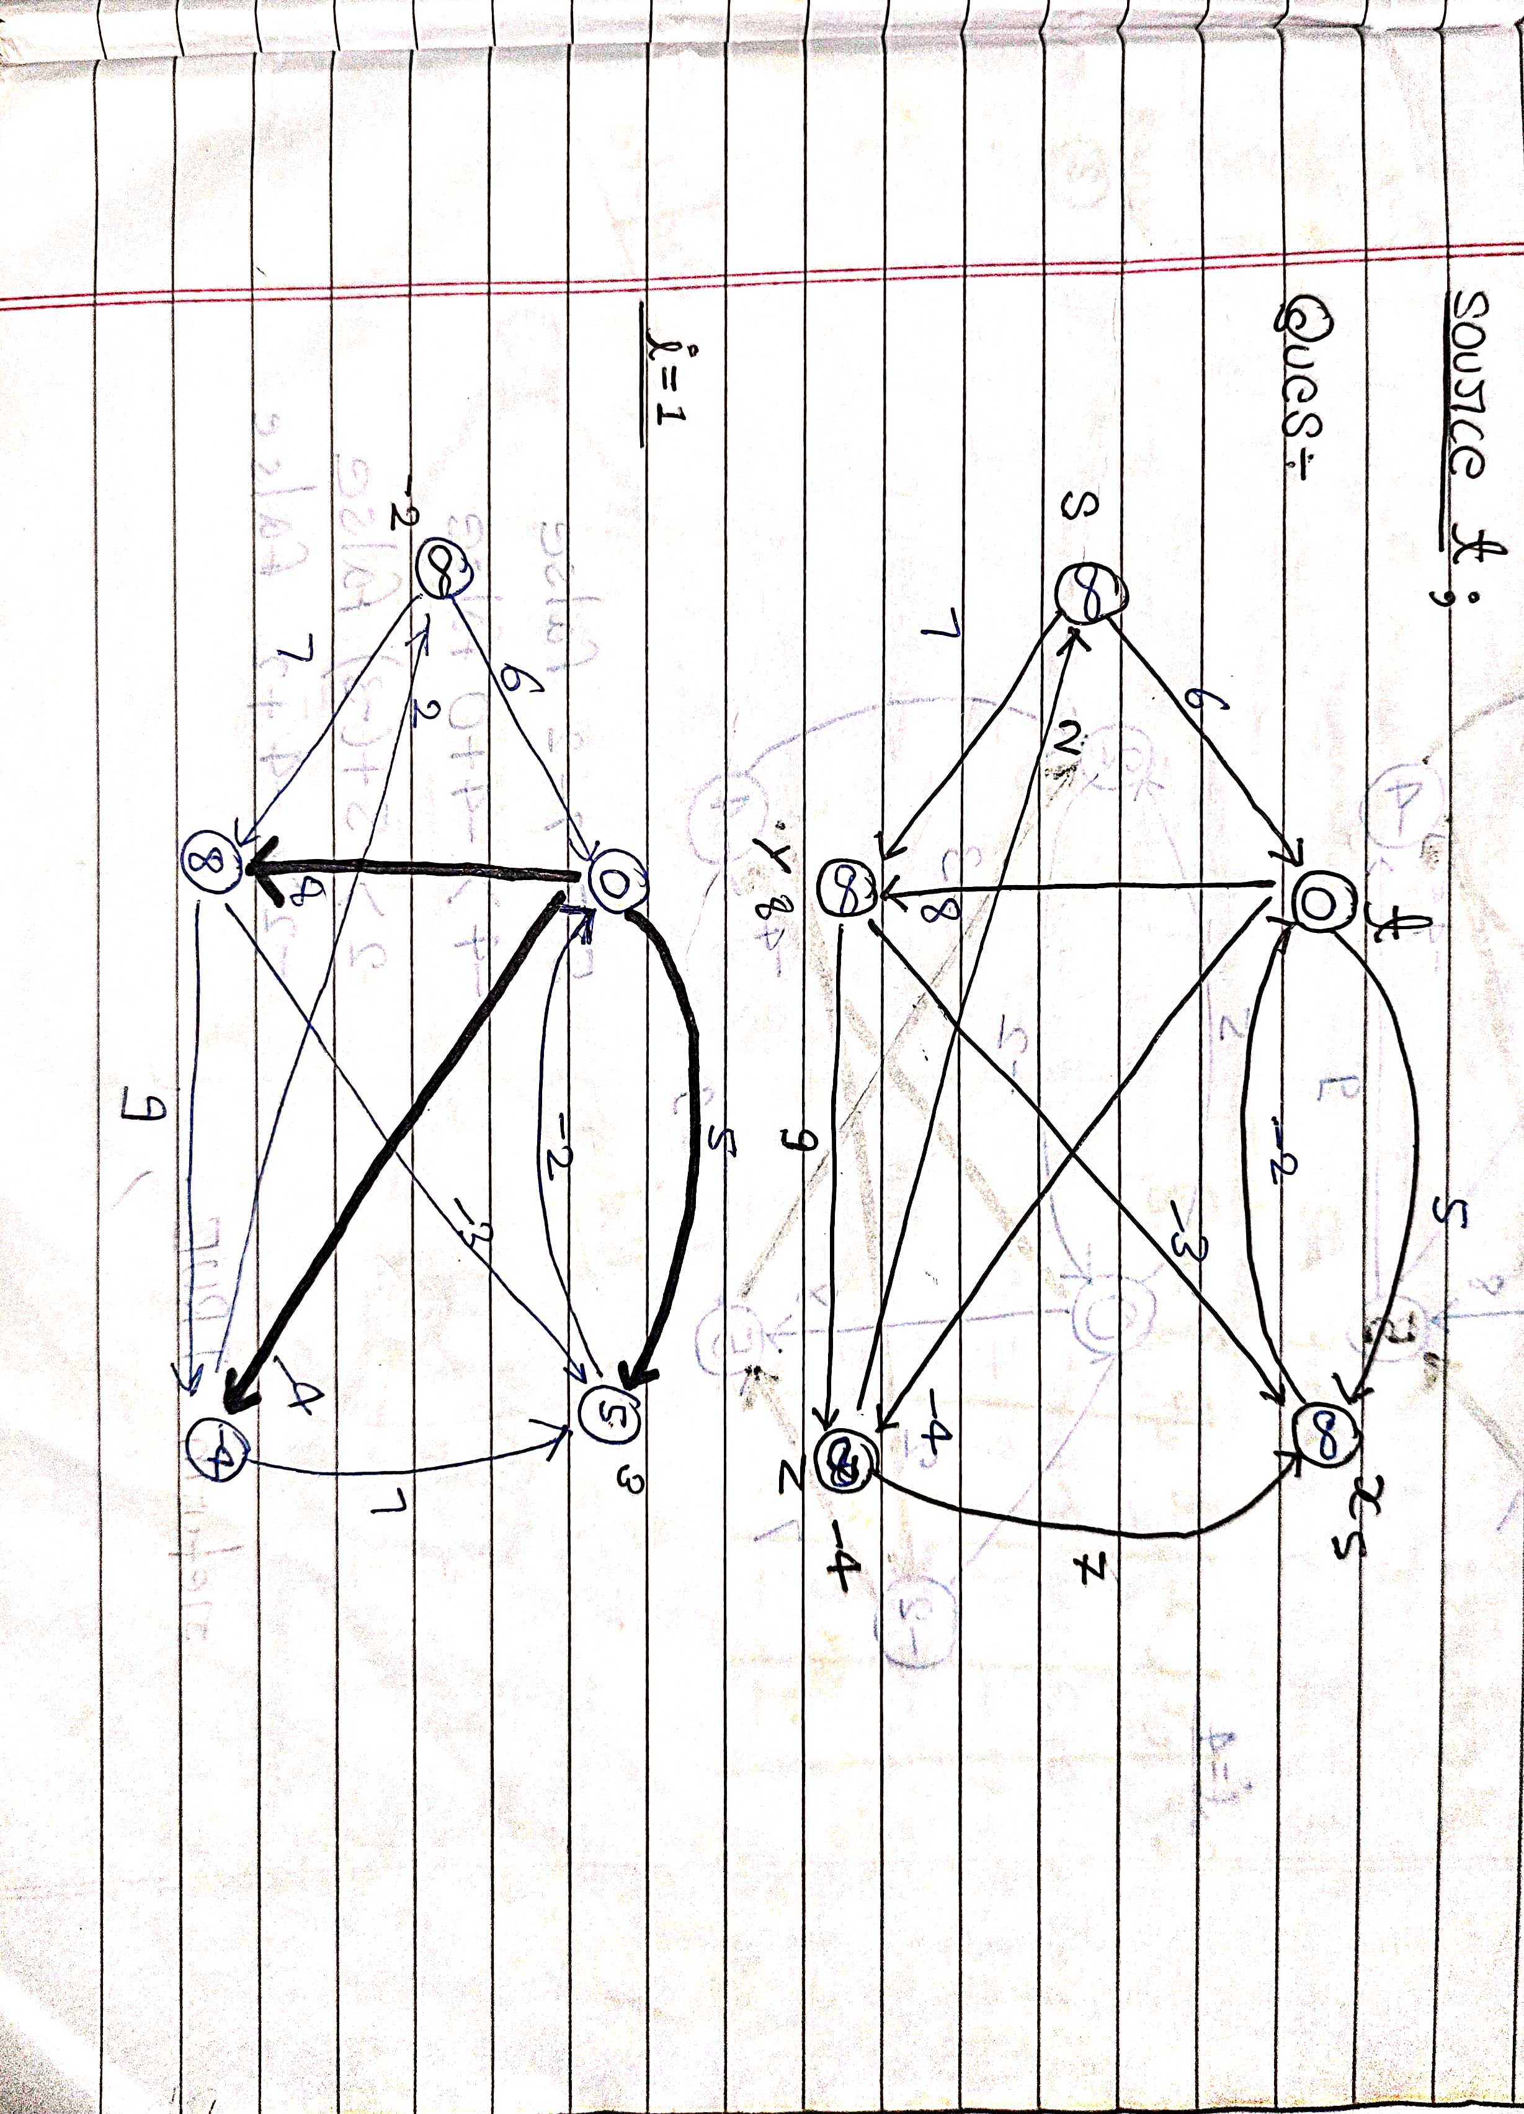

Slide 8
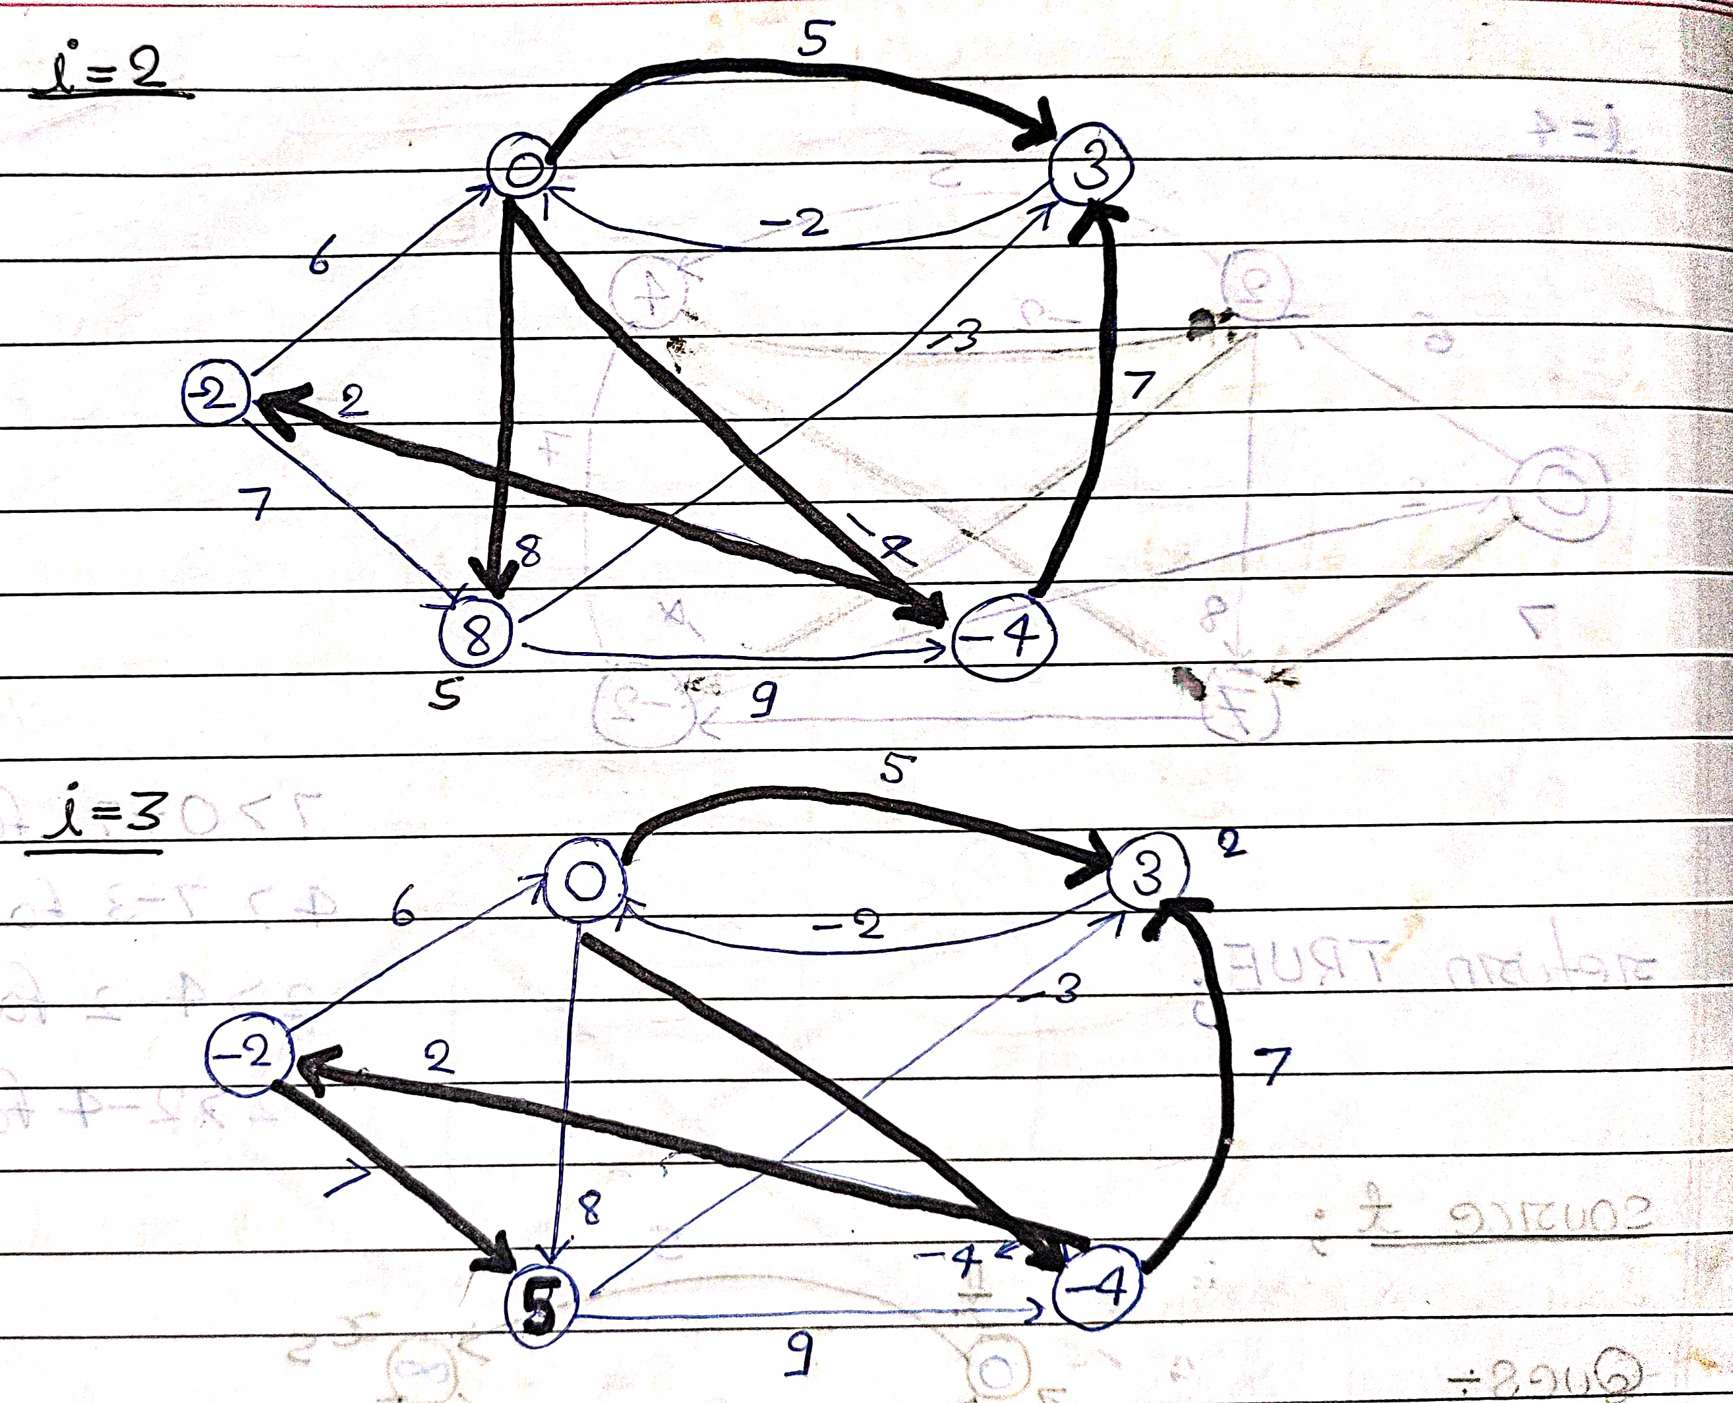

Slide 9
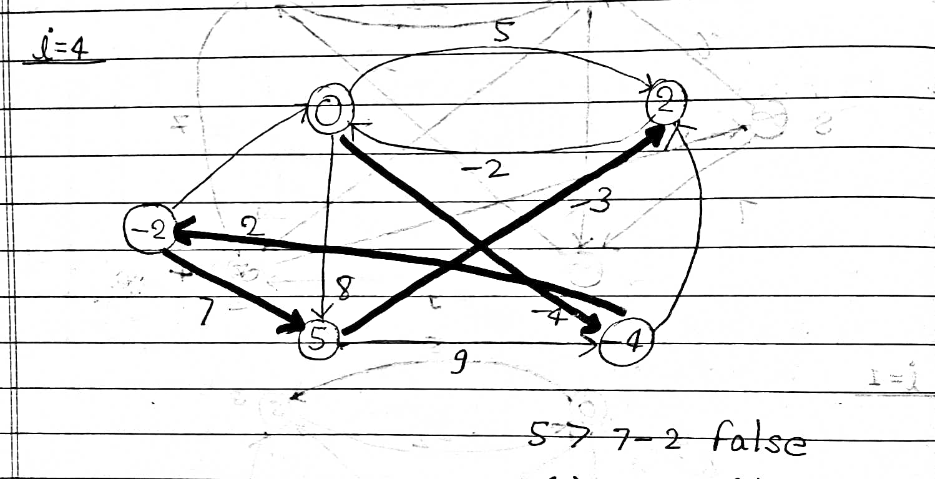

Slide 10
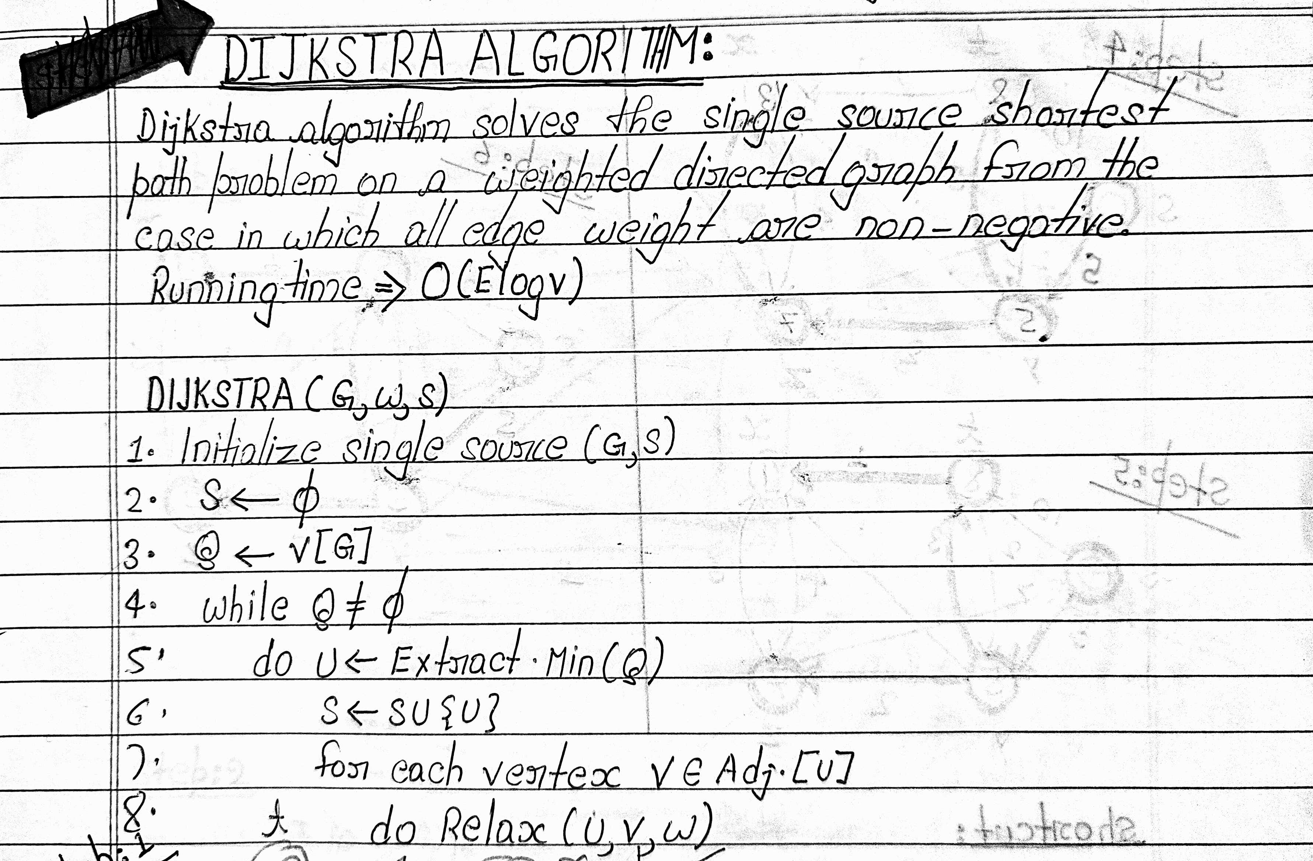

Slide 11
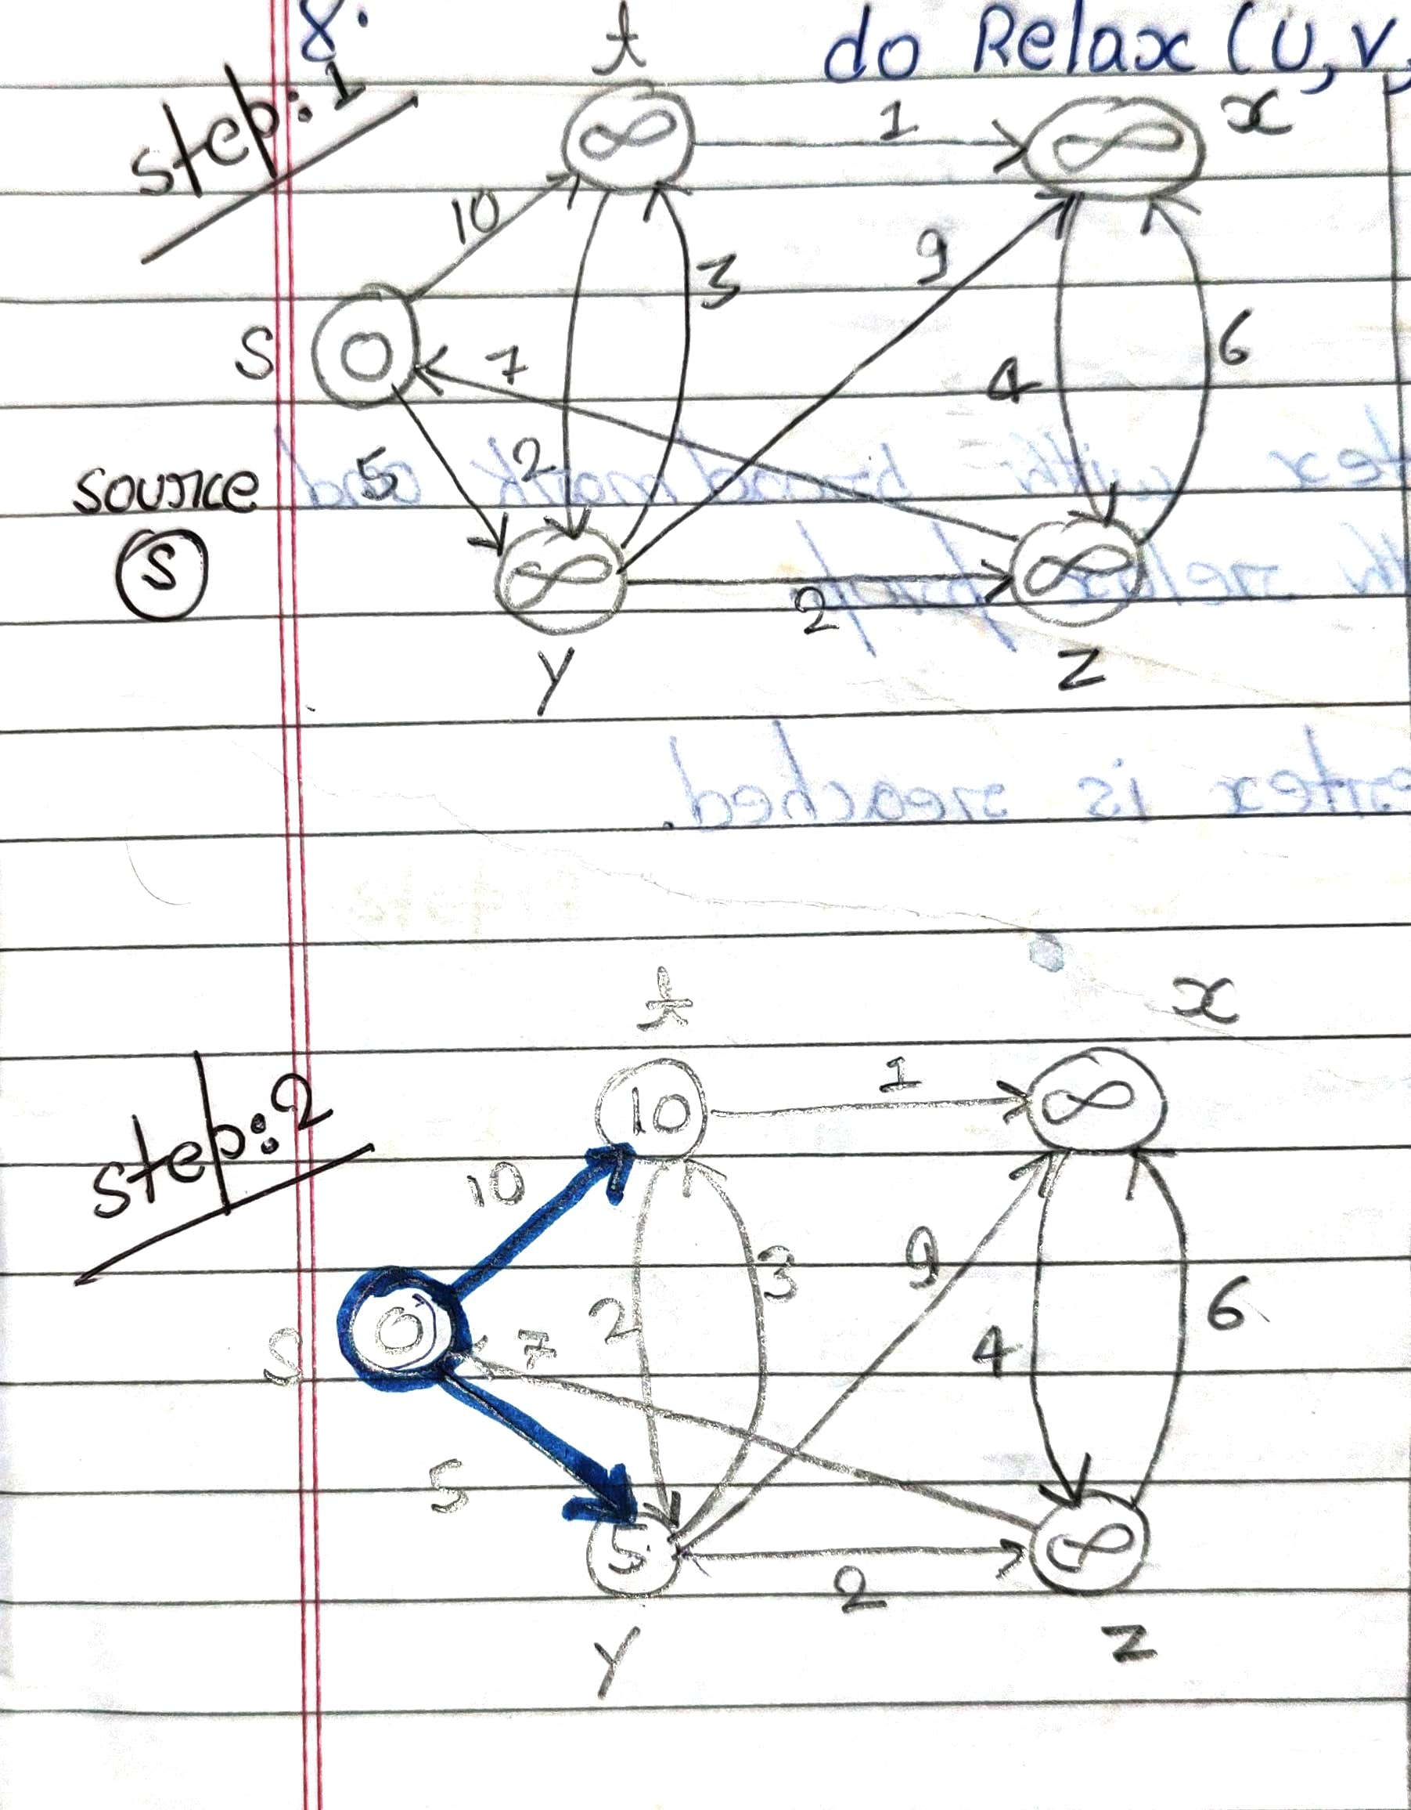
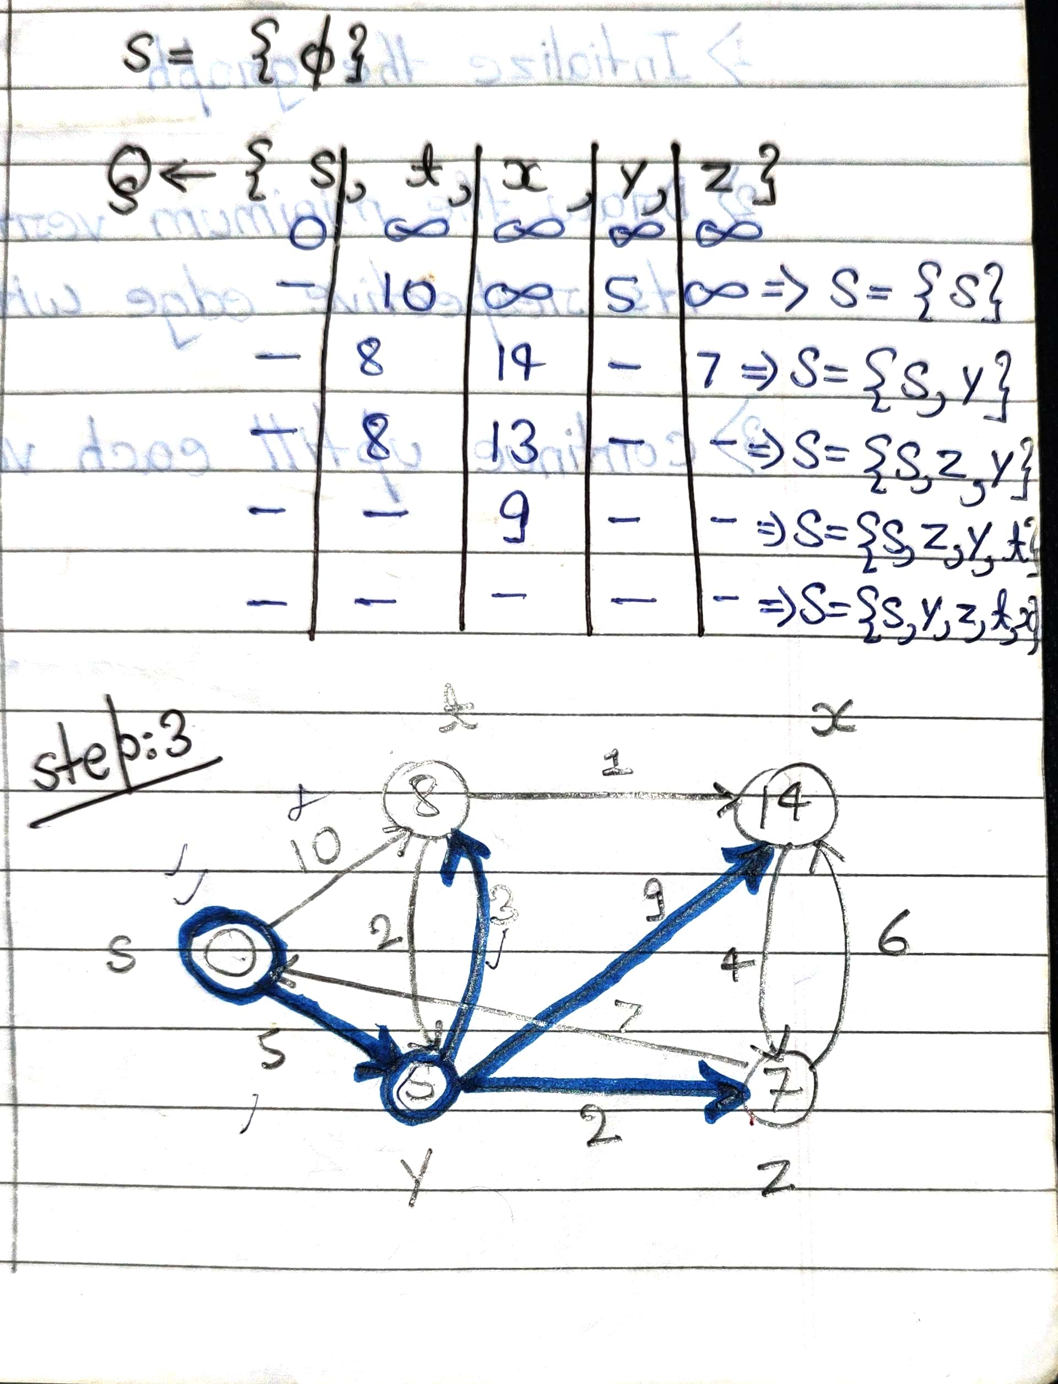

Slide 12
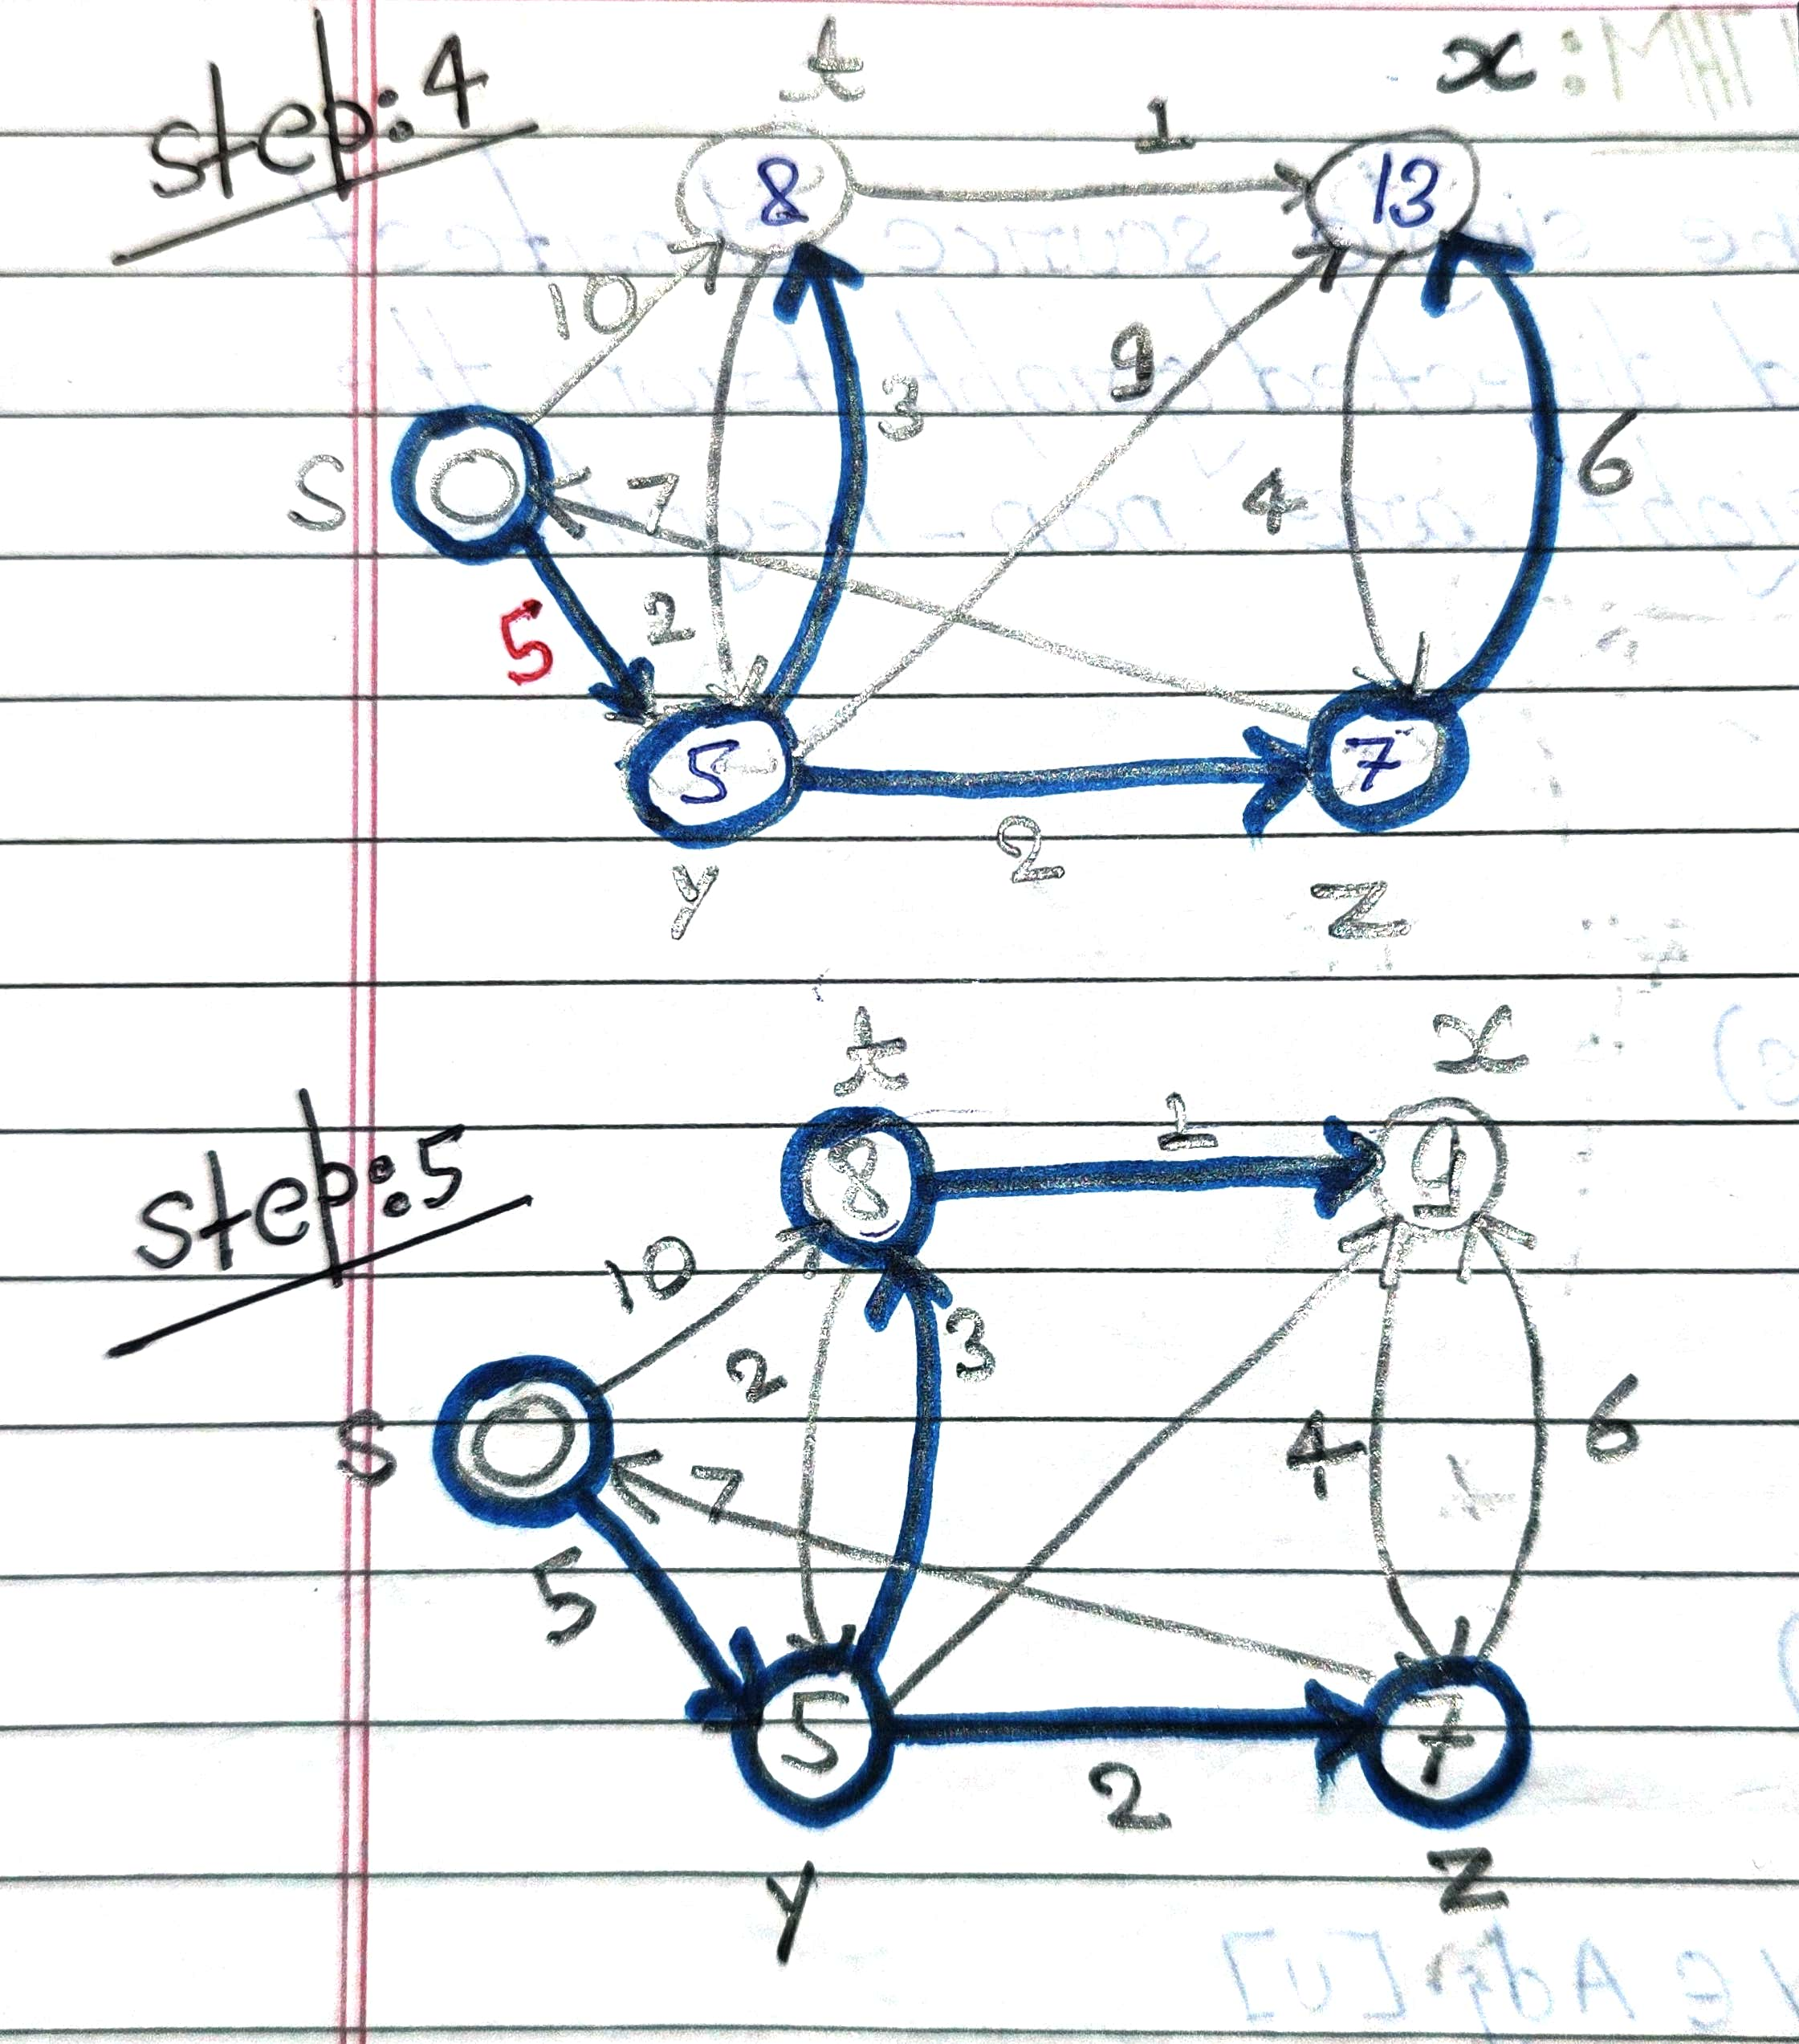
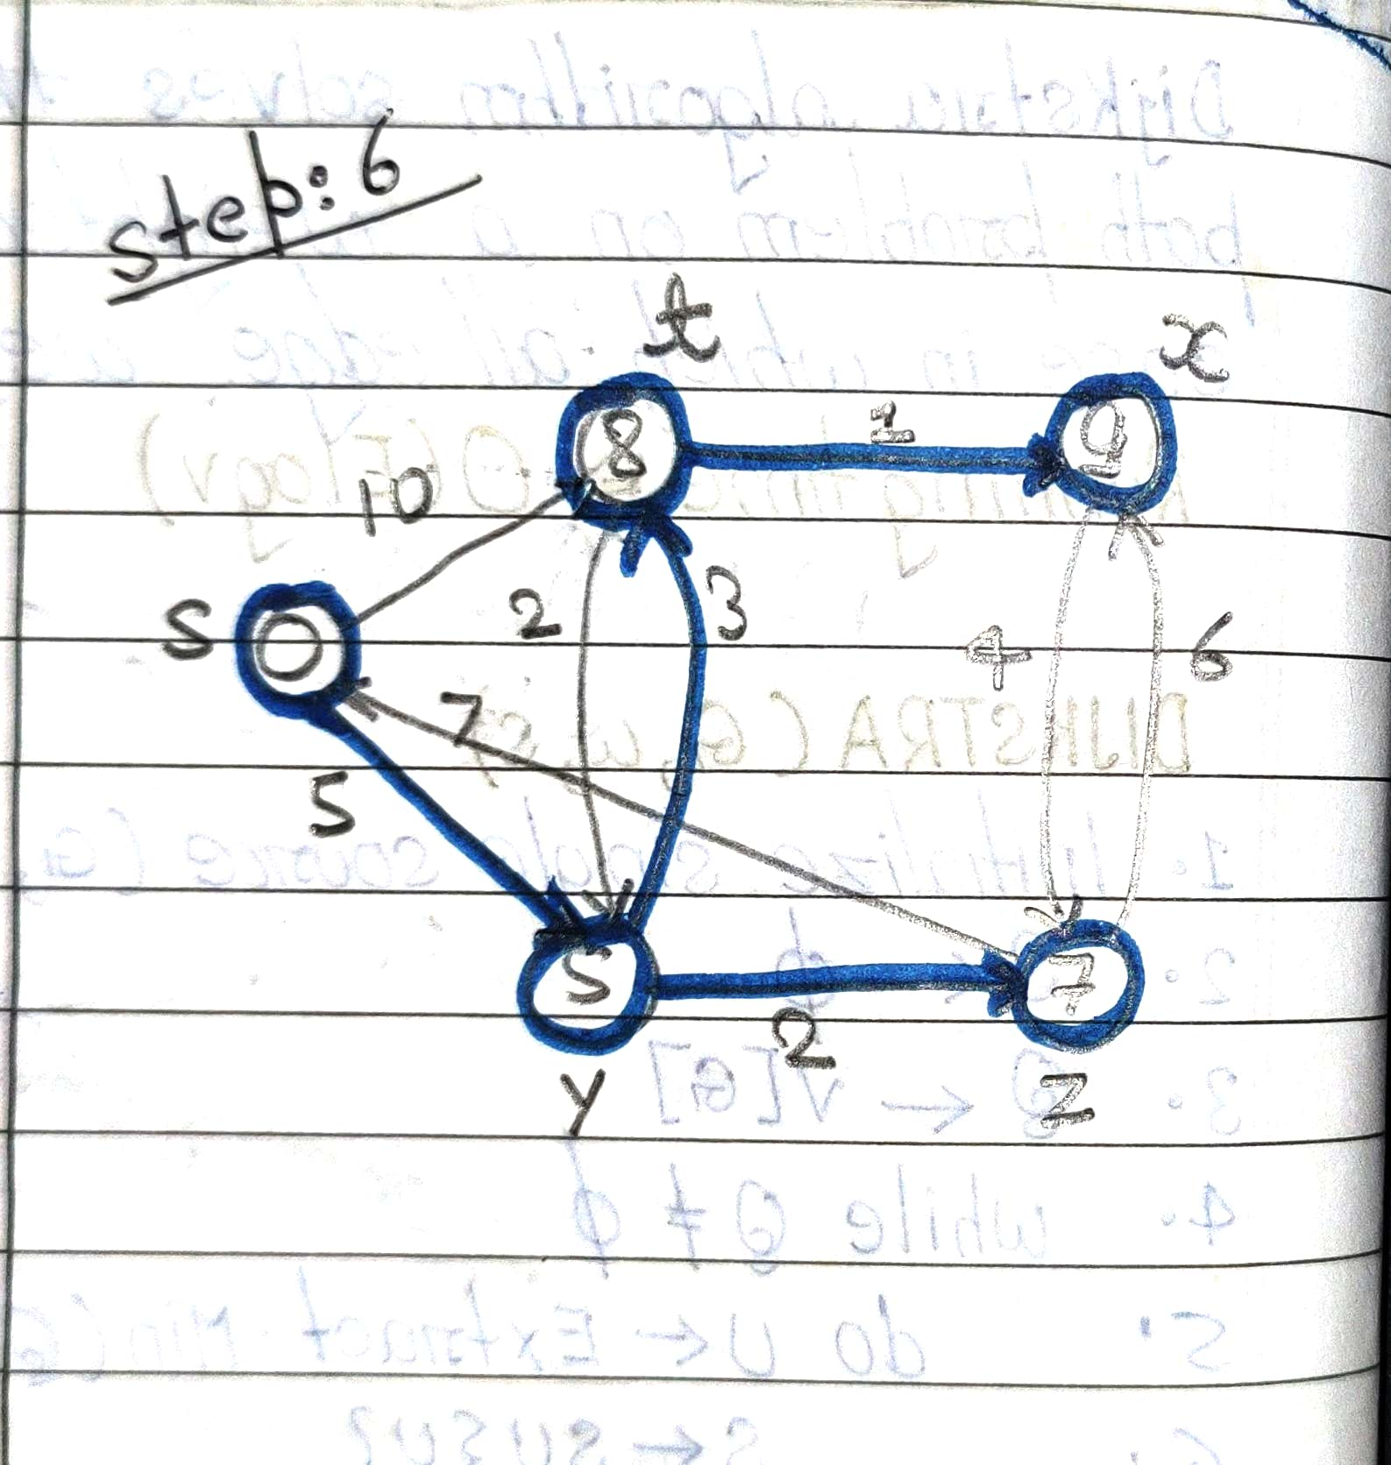
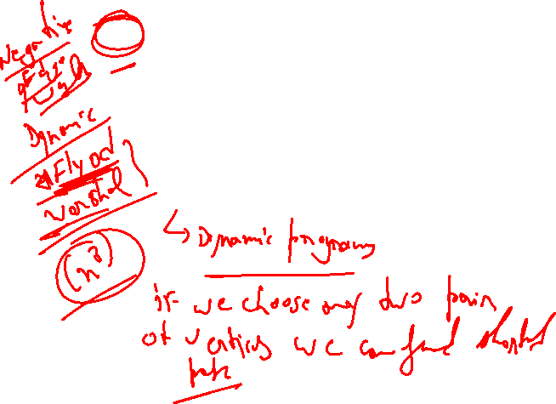

Slide 13
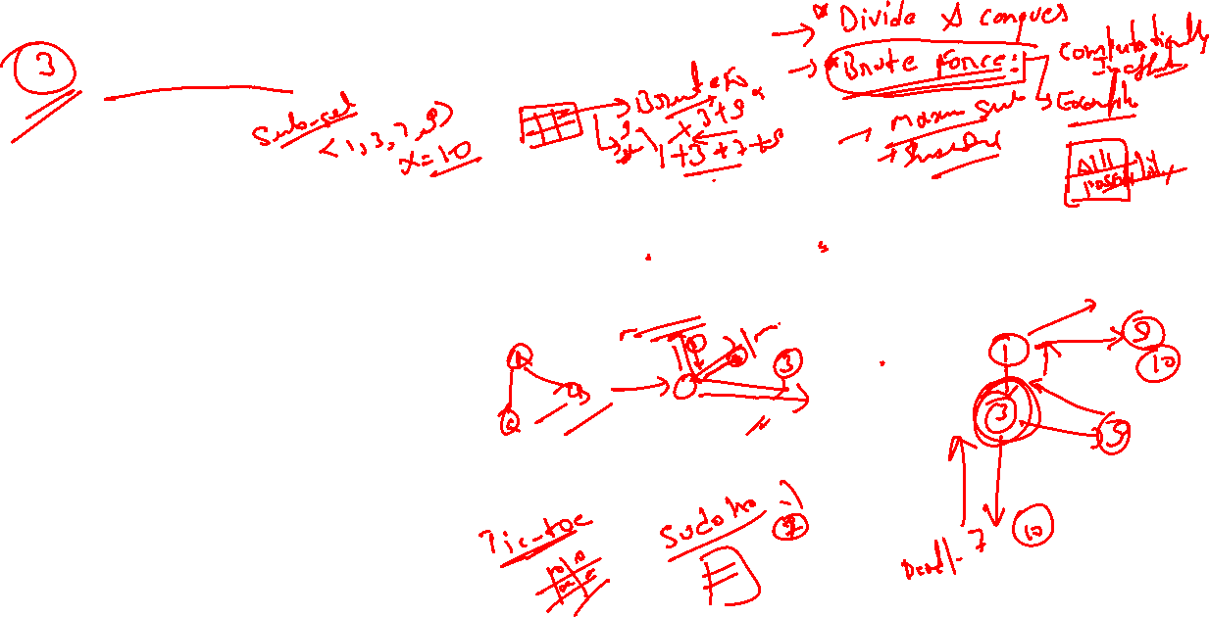
Backtracking Solution
Backtracking is an effective approach to solve the N-Queens problem.
The idea is to place queens one by one in different columns and check if they are in a valid position.
If a valid placement is found, proceed to place the next queen, otherwise backtrack.

Slide 14
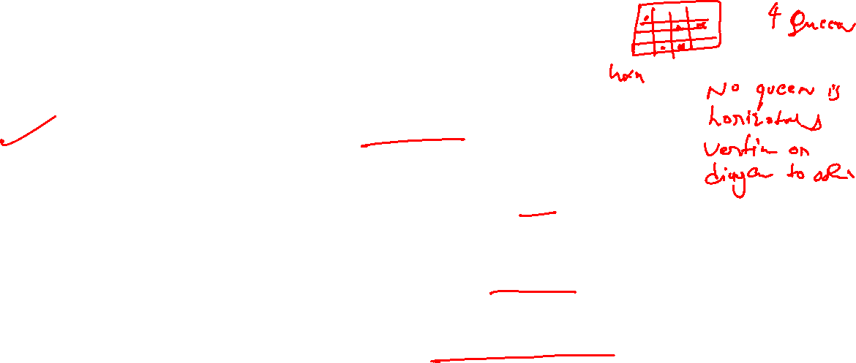
Pseudocode for Backtracking
1. Start by placing the first queen in the first column.
2. For each column, try placing the queen in a valid row.
3. If a queen can be placed, move to the next column and repeat.
4. If no valid position is found, backtrack to the previous column.

Slide 15
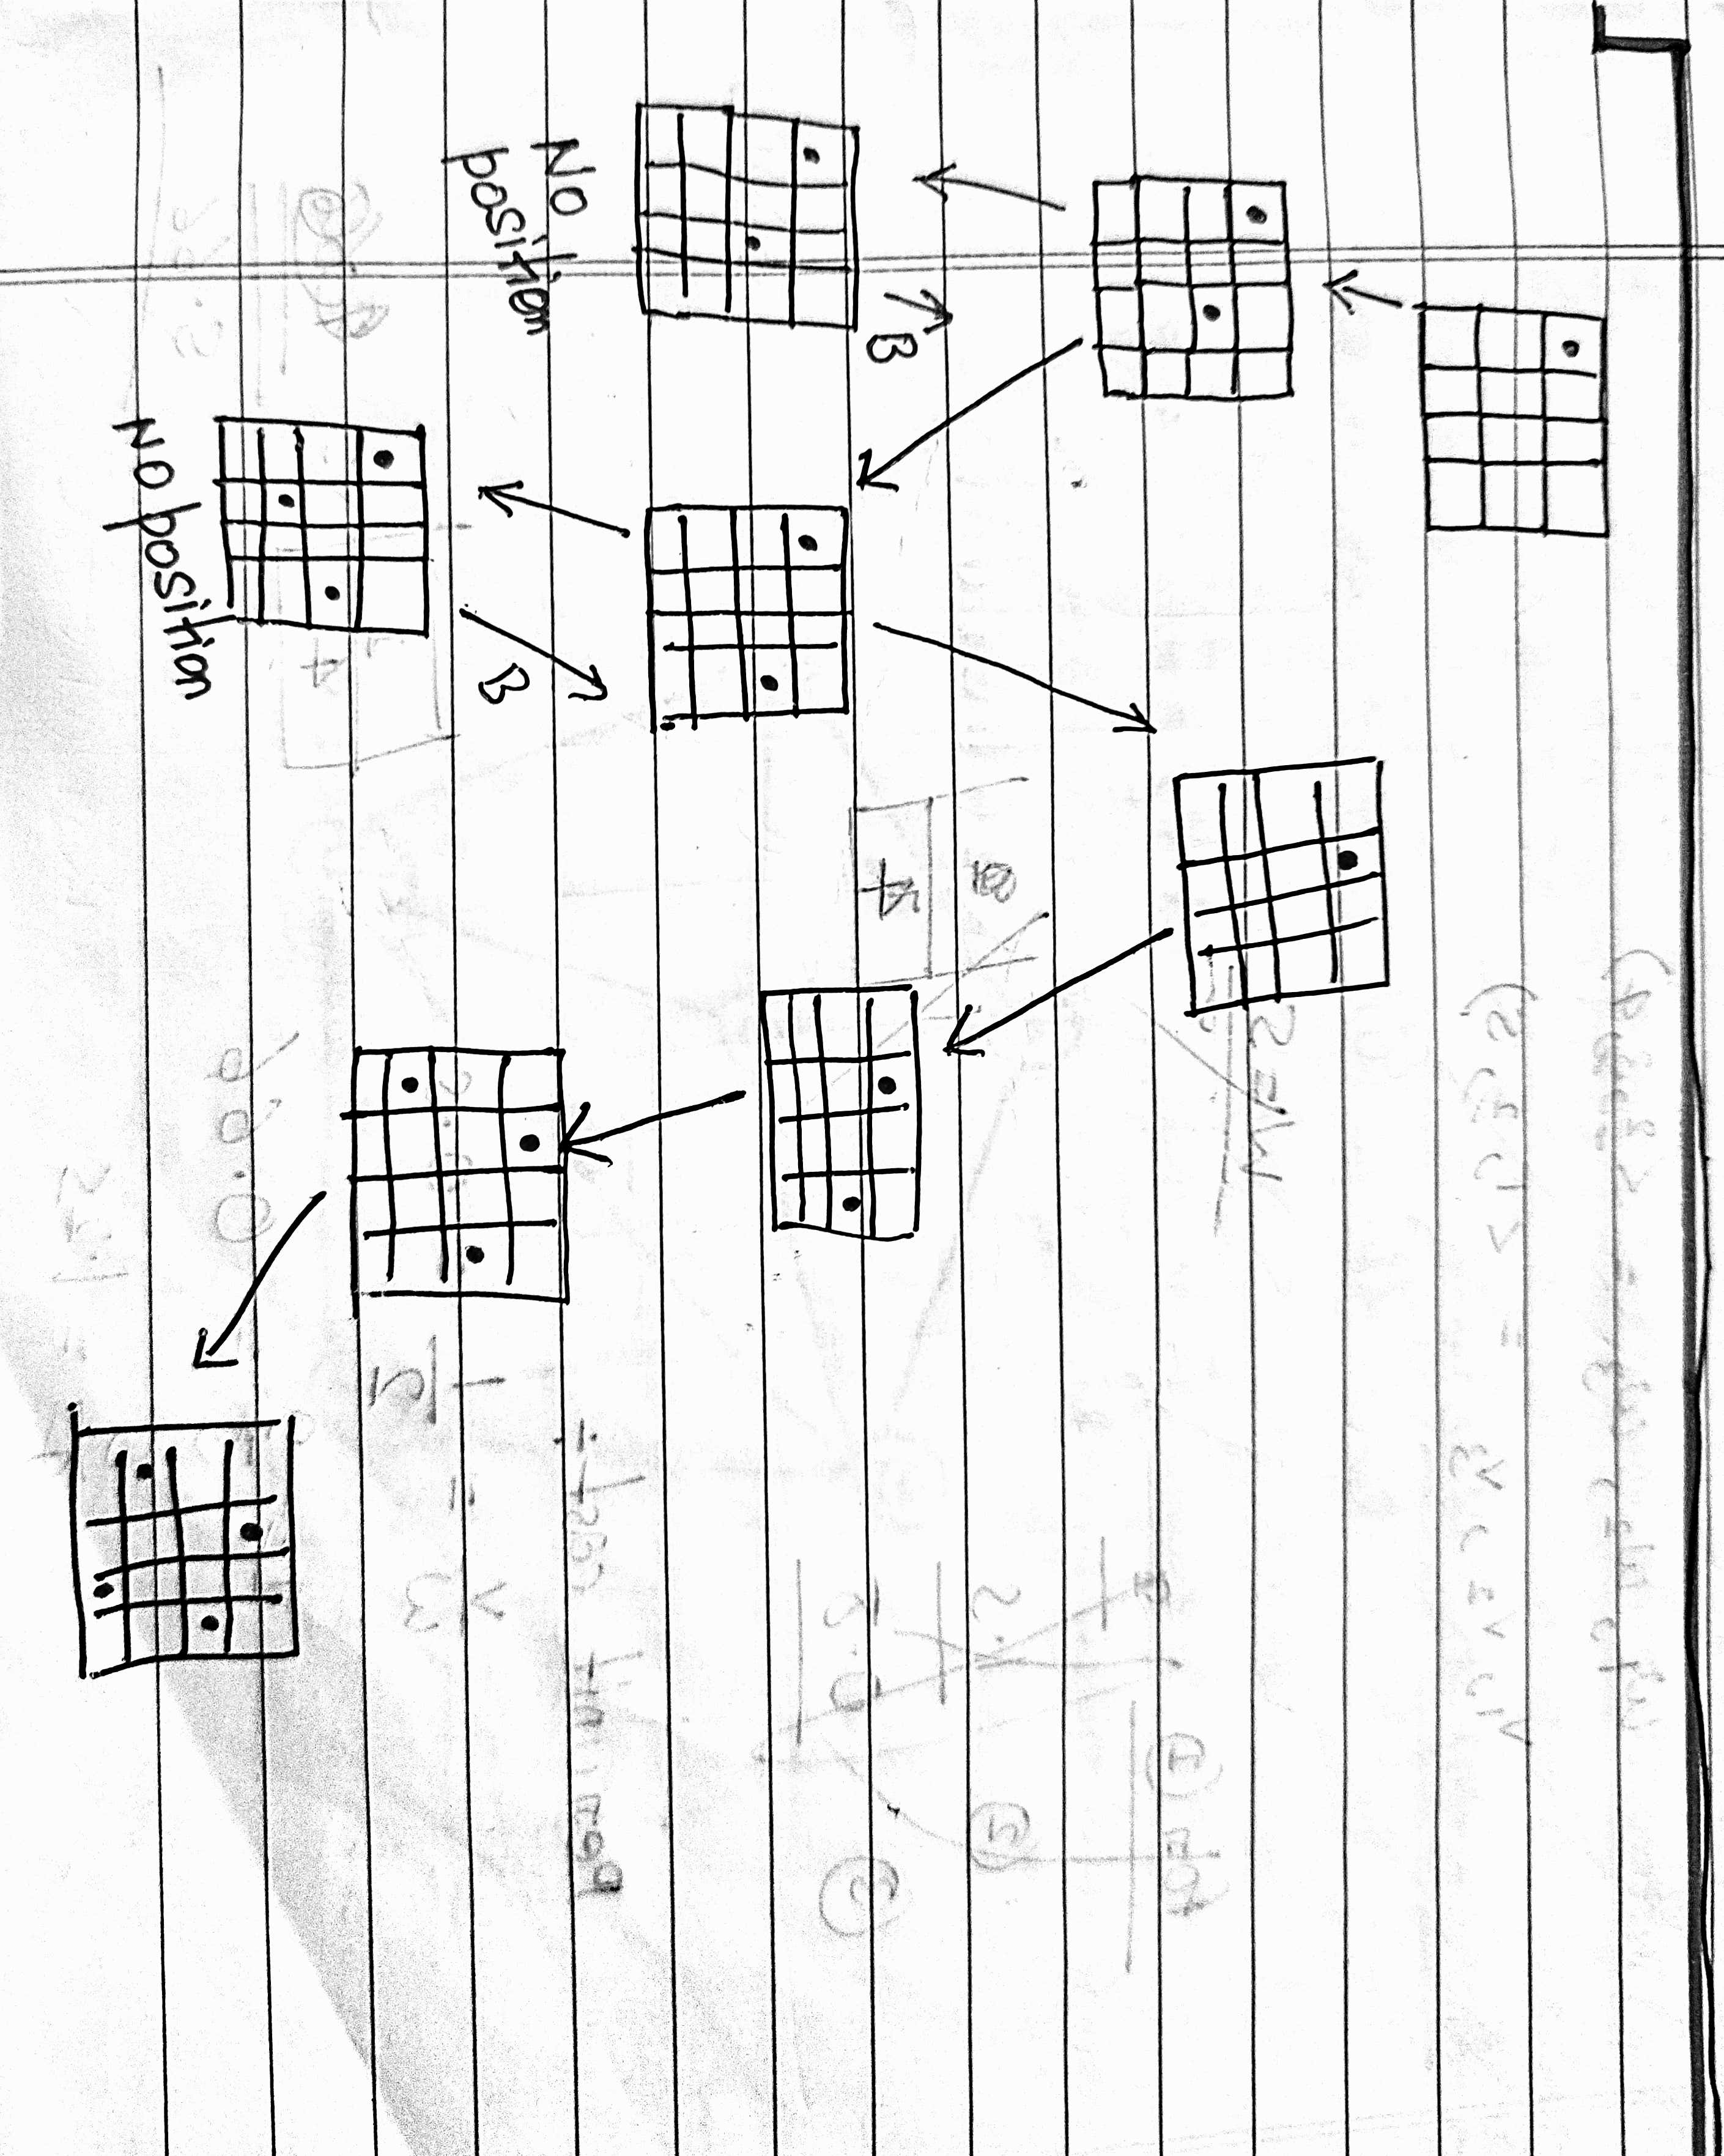
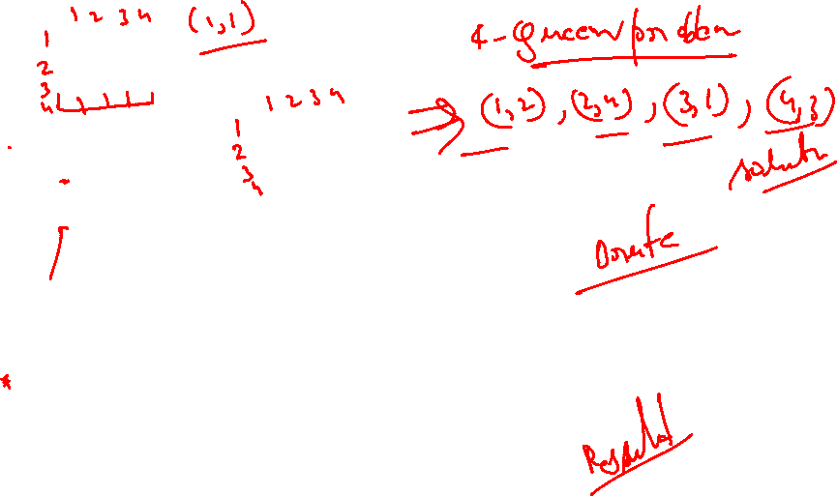

Slide 16
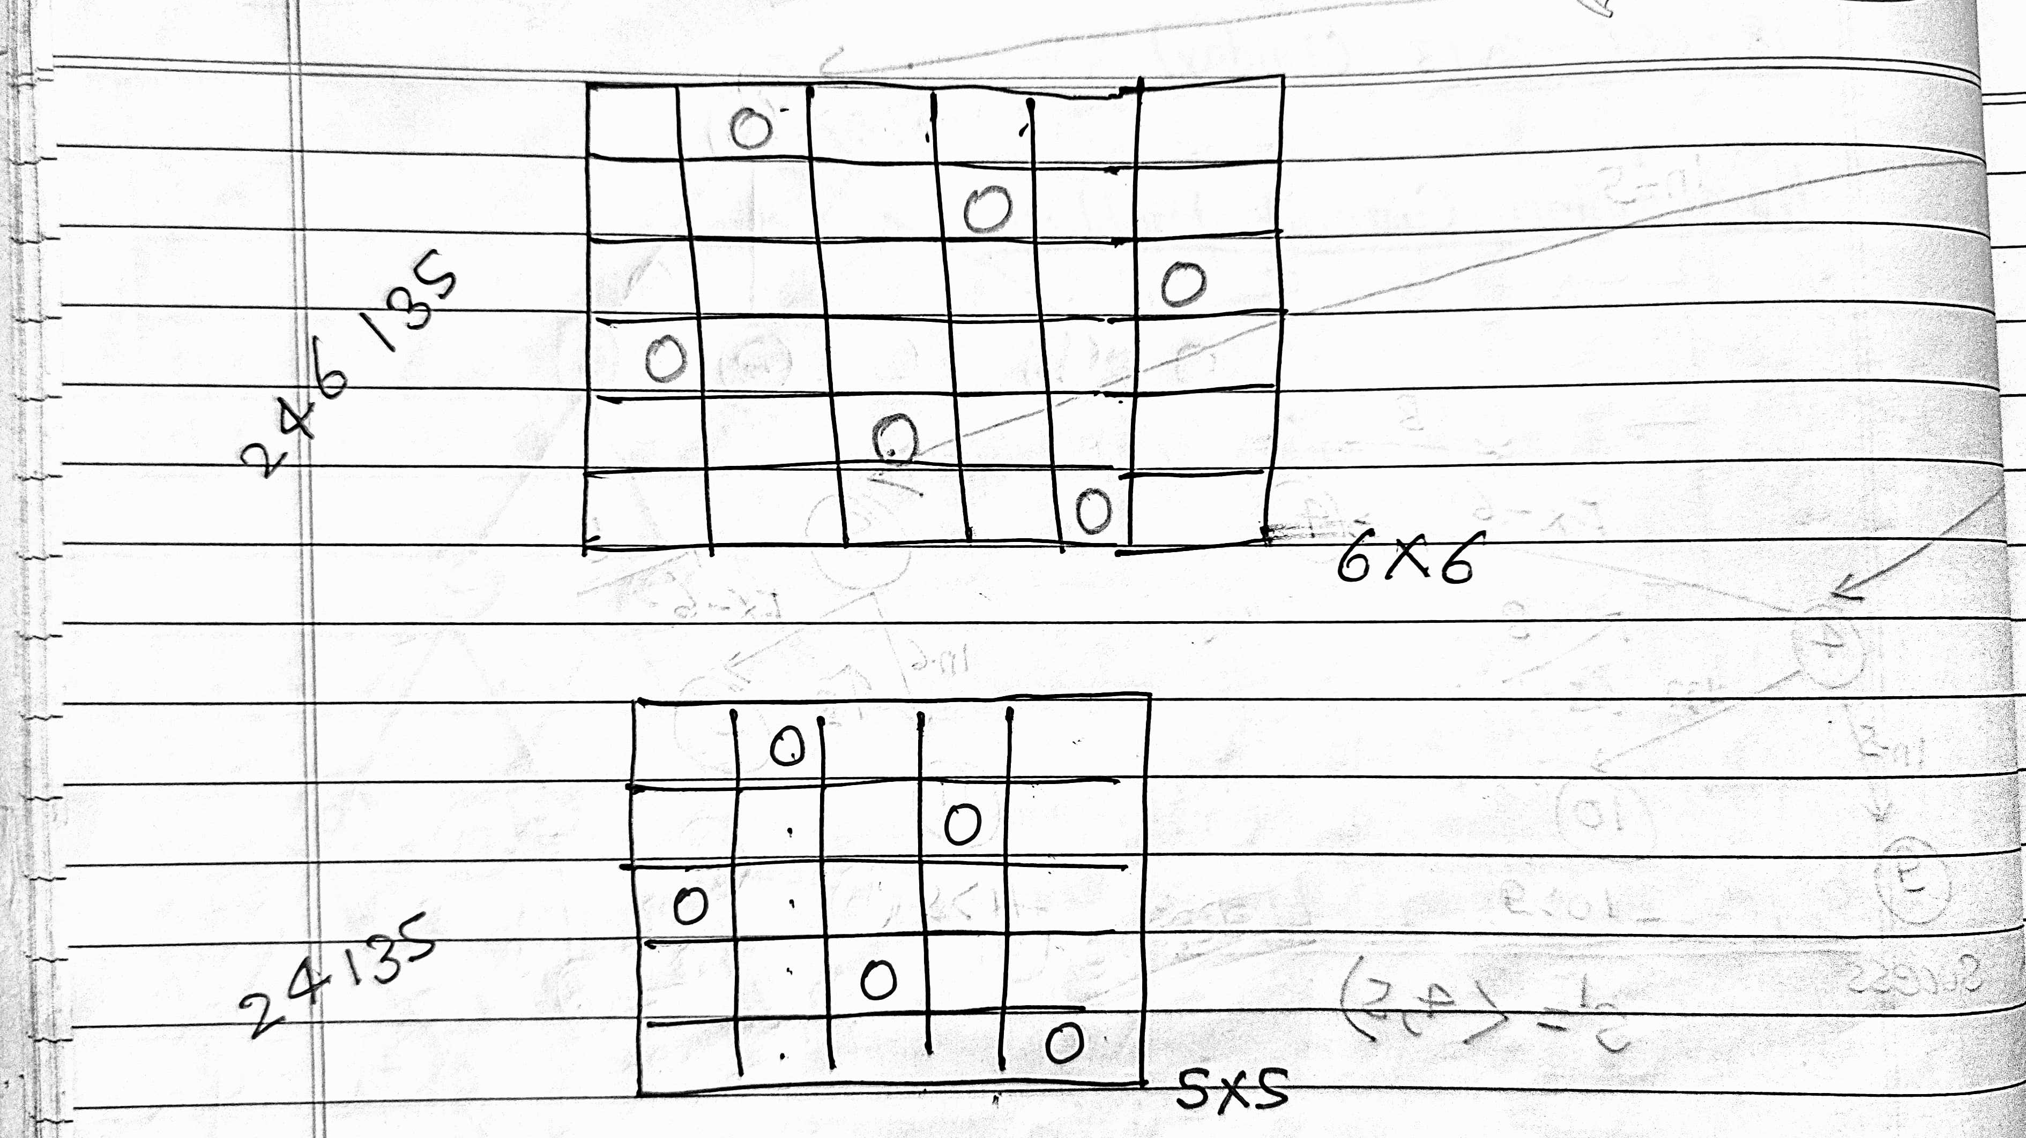
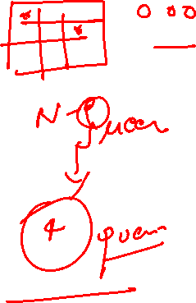

Slide 17

Time Complexity
The time complexity of the N-Queens problem using backtracking is O(N!).
This is because for each queen, we need to check multiple positions and validate constraints.
Efficient pruning techniques can help reduce the search space.

Slide 18
Visualization of Backtracking
Backtracking explores all possible configurations of queen placements.
When a conflict is detected (two queens threatening each other), the algorithm backtracks to the previous step.
This process continues until all valid solutions are found.

Slide 19
Advantages and Challenges
Advantages:
- Simple to implement.
- Guarantees a solution if one exists.
Challenges:
- High time complexity (O(N!)).
- Not efficient for large N without optimizations.

Slide 20
A Hamiltonian cycle (or Hamiltonian circuit) is a concept from graph theory that refers to a cycle in a graph that visits each vertex exactly once and returns to the starting vertex. This is different from an Eulerian cycle, which requires visiting each edge exactly once.
Key Characteristics:
Cycle: It starts and ends at the same vertex.
Visits all vertices: Each vertex of the graph must be visited exactly once.
Undirected or Directed Graphs: Hamiltonian cycles can exist in both undirected and directed graphs.
Example: Consider a graph with vertices A, B, C, D:
- A possible Hamiltonian cycle would be: A → B → C → D → A
Hamiltonian Path vs. Hamiltonian Cycle:
- A Hamiltonian path visits every vertex exactly once but doesn't necessarily return to the starting point.
- A Hamiltonian cycle is a closed path (it returns to the starting point).

Slide 21
Applications:
Traveling Salesman Problem (TSP): This is a famous problem in combinatorial optimization where one needs to find the shortest Hamiltonian cycle in a weighted graph.
Routing and Circuit Design: Hamiltonian cycles are used in designing efficient routes or circuits that need to pass through specific points exactly once.
Challenges:
NP-Complete: Determining whether a Hamiltonian cycle exists in a given graph is NP-complete, meaning it's computationally difficult to solve for large graphs.
Would you like an example, or an algorithm related to finding Hamiltonian cycles?

Slide 22
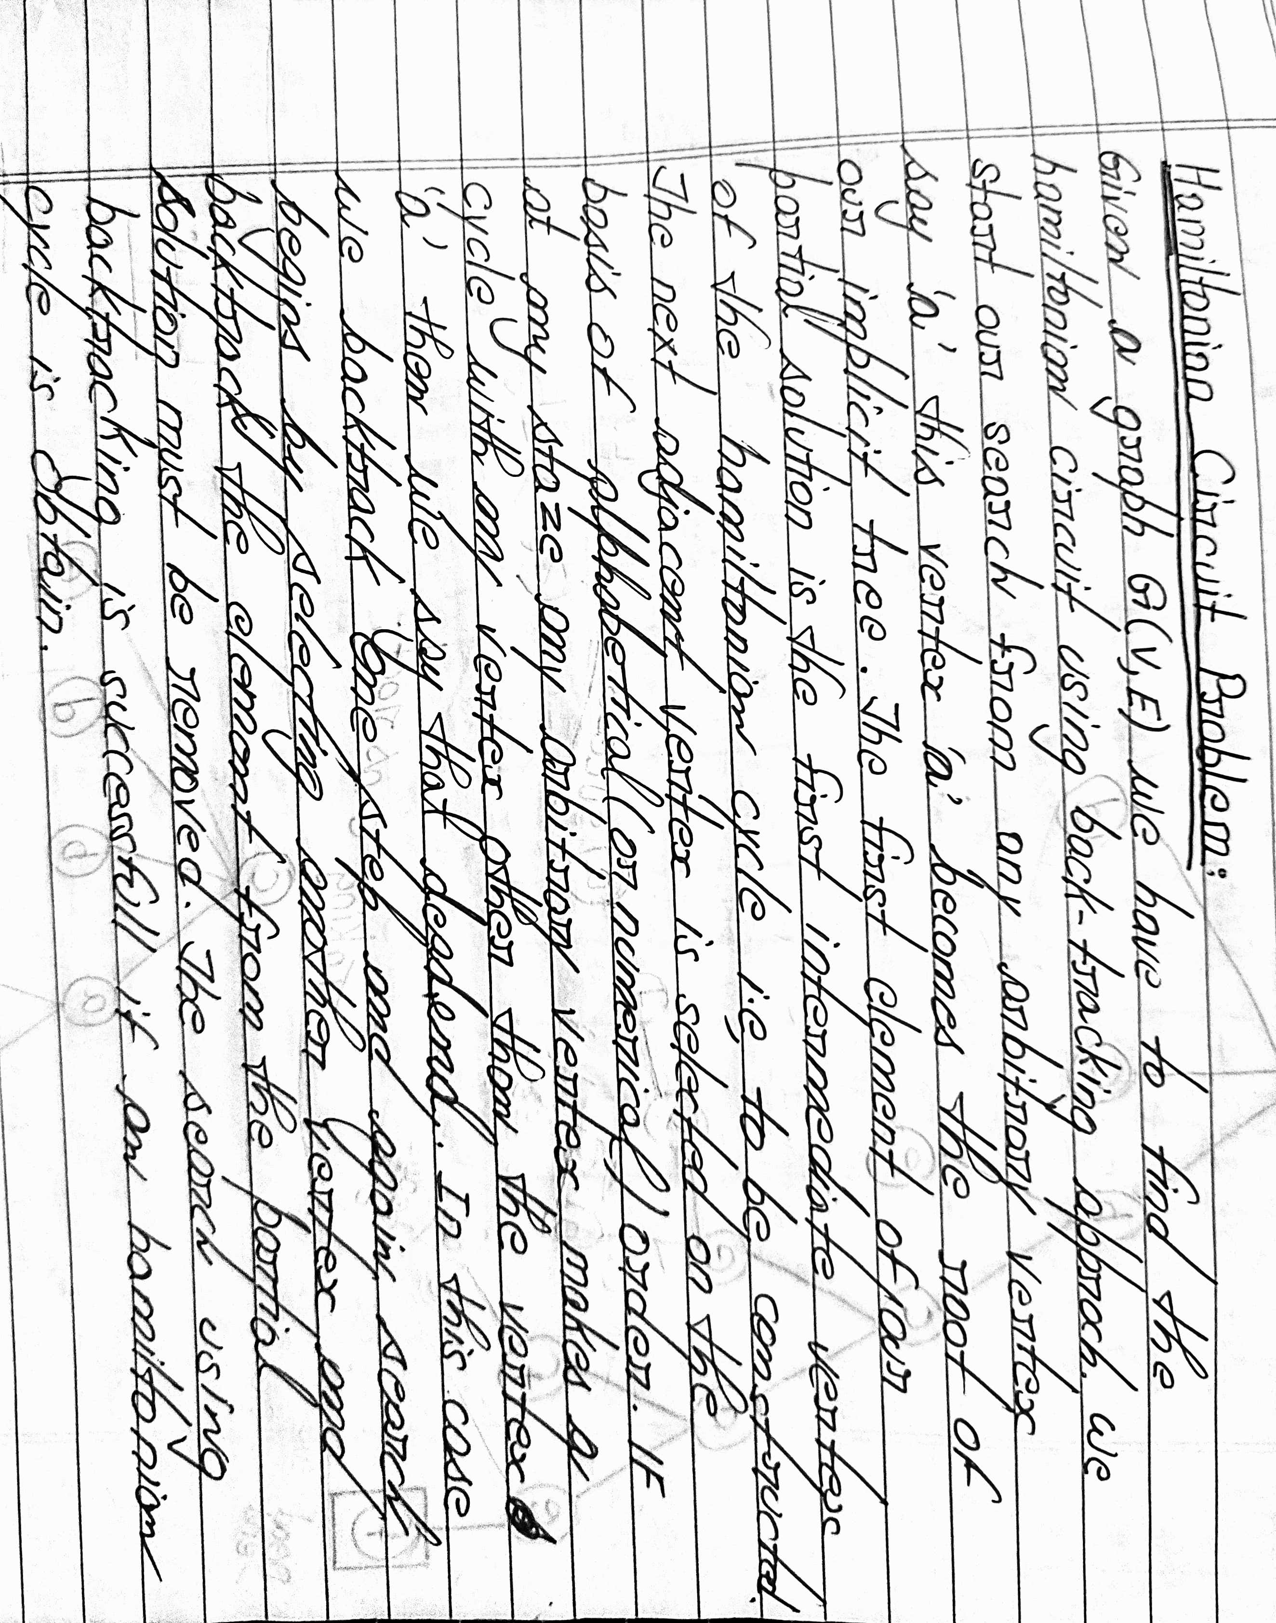
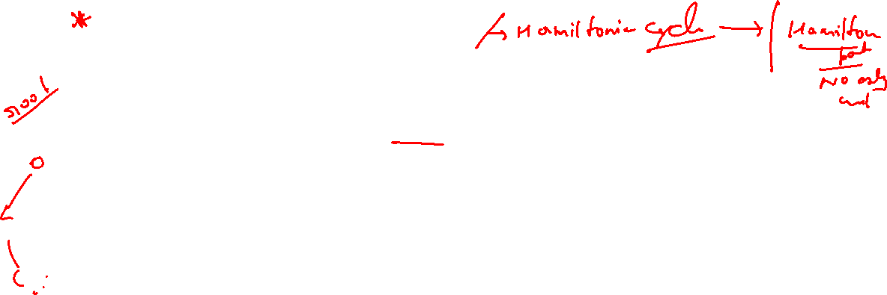

Slide 23
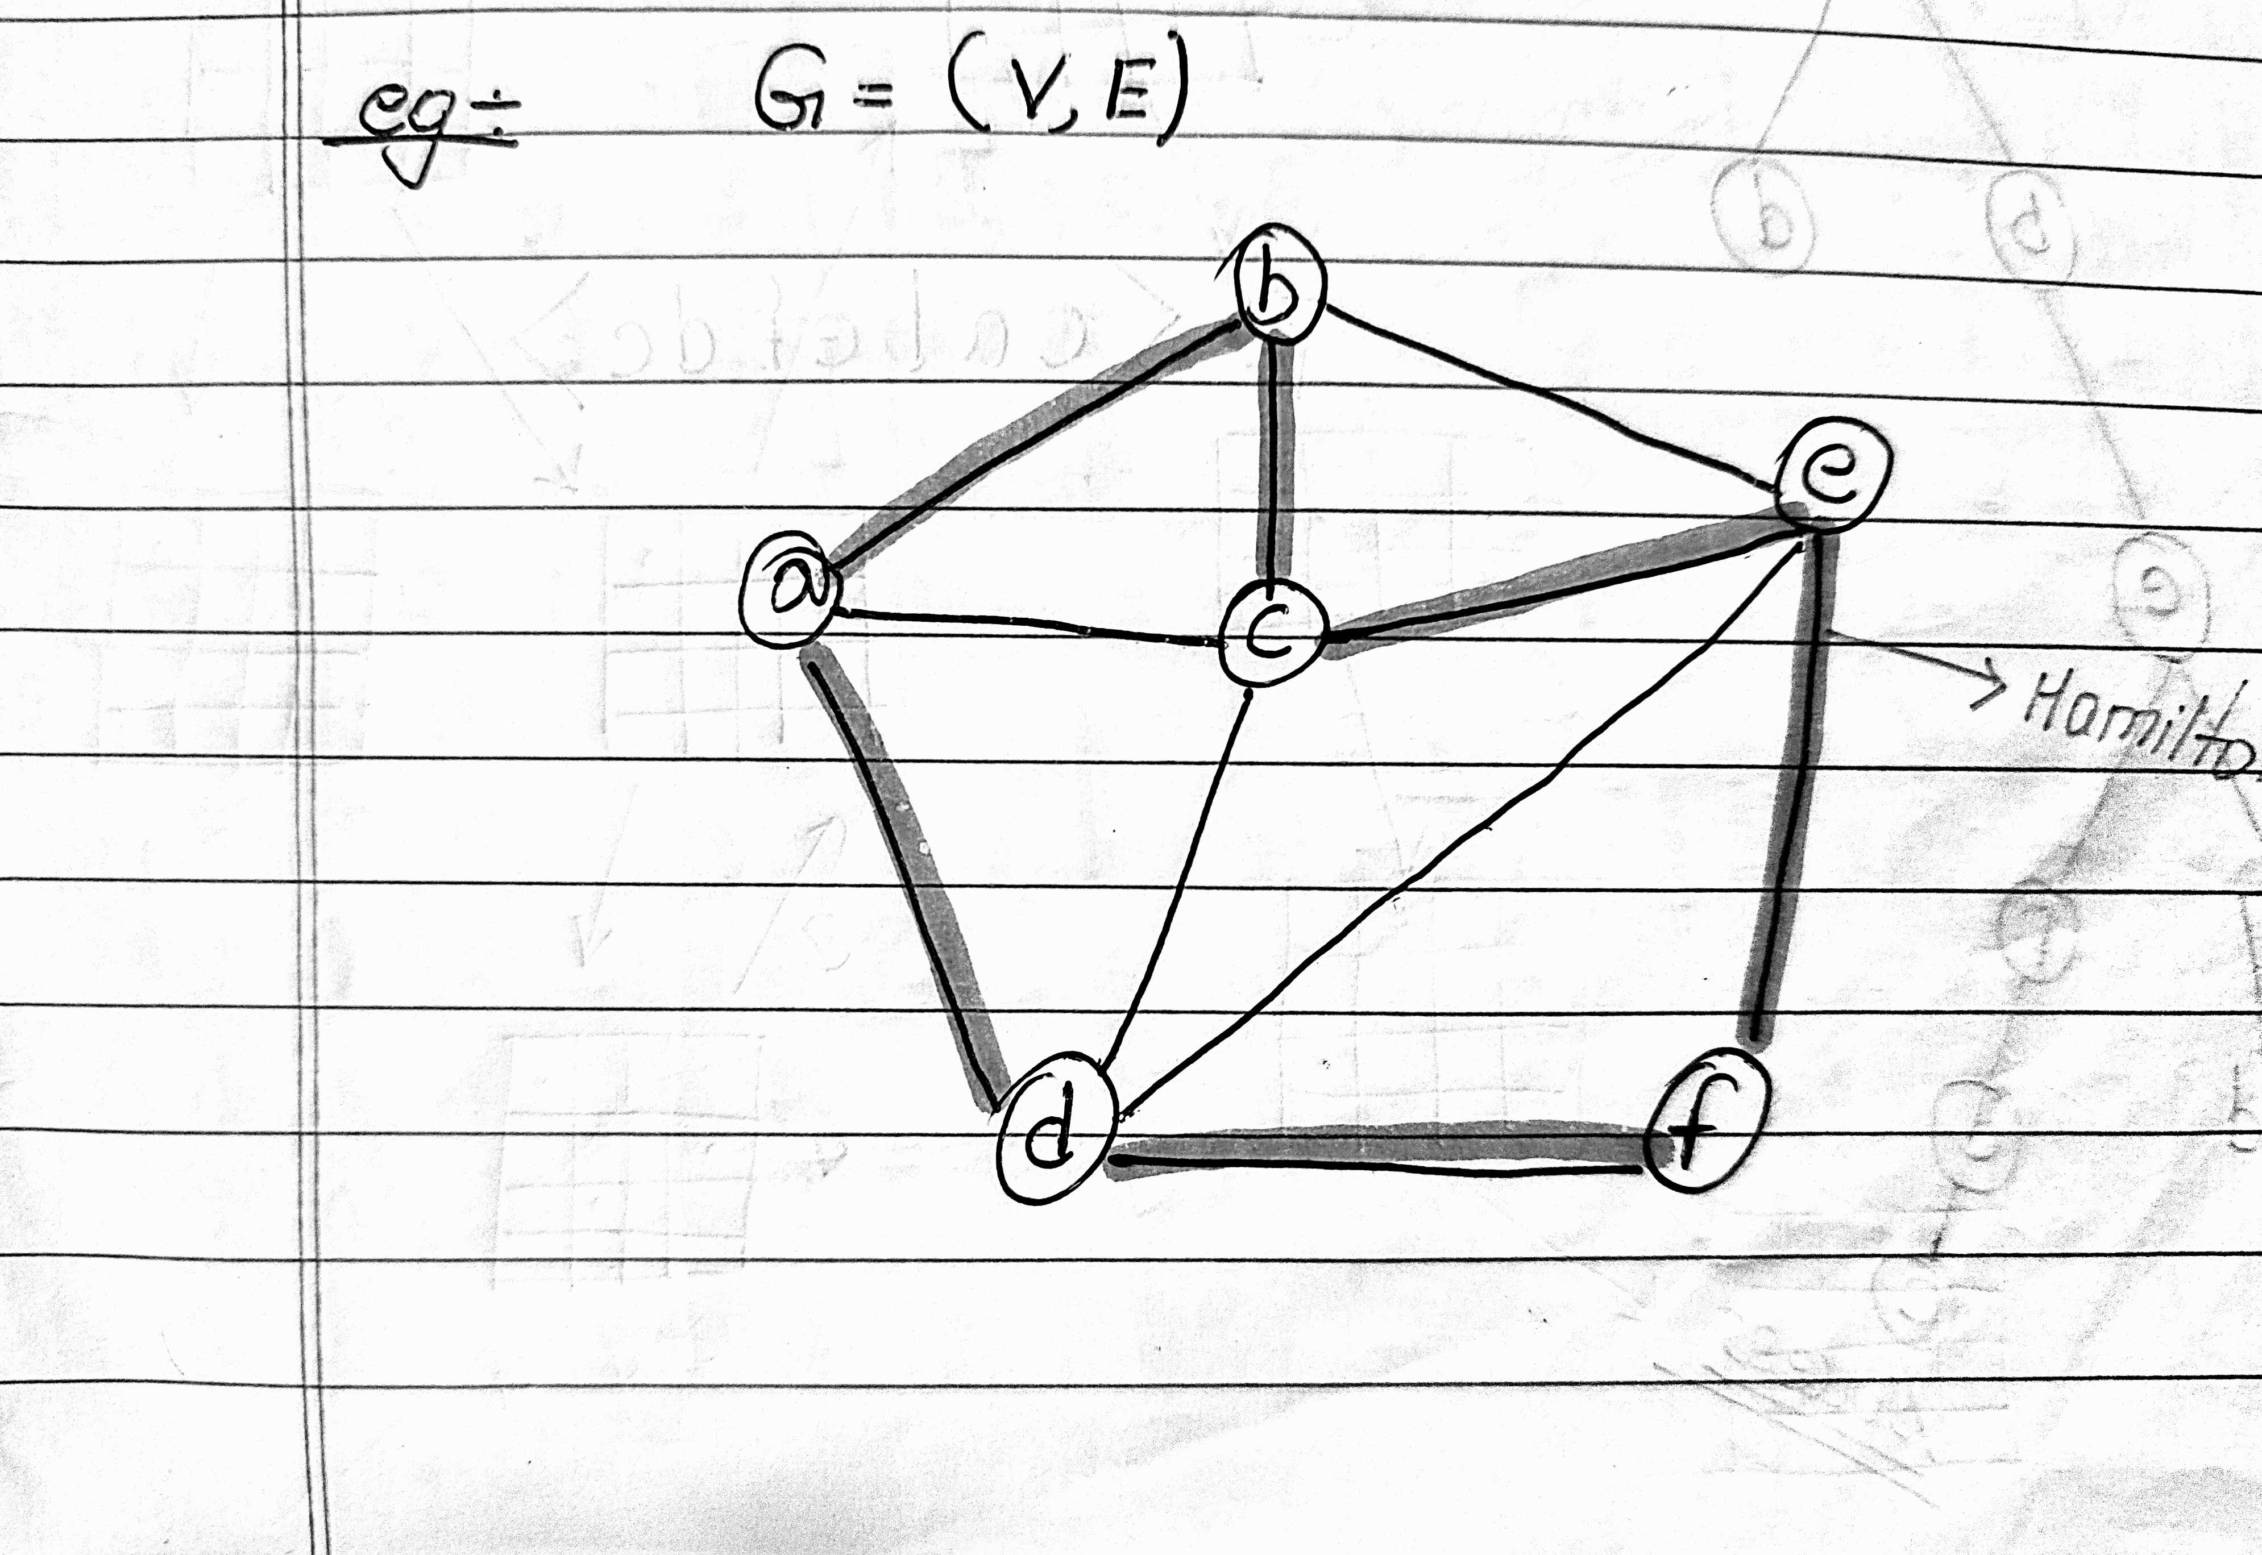
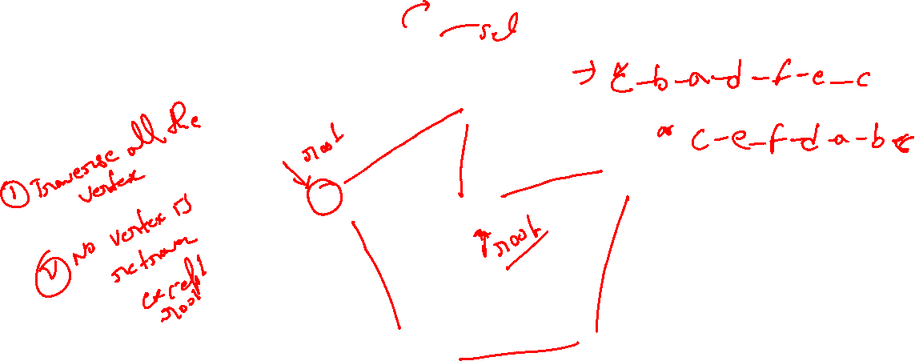

Slide 24
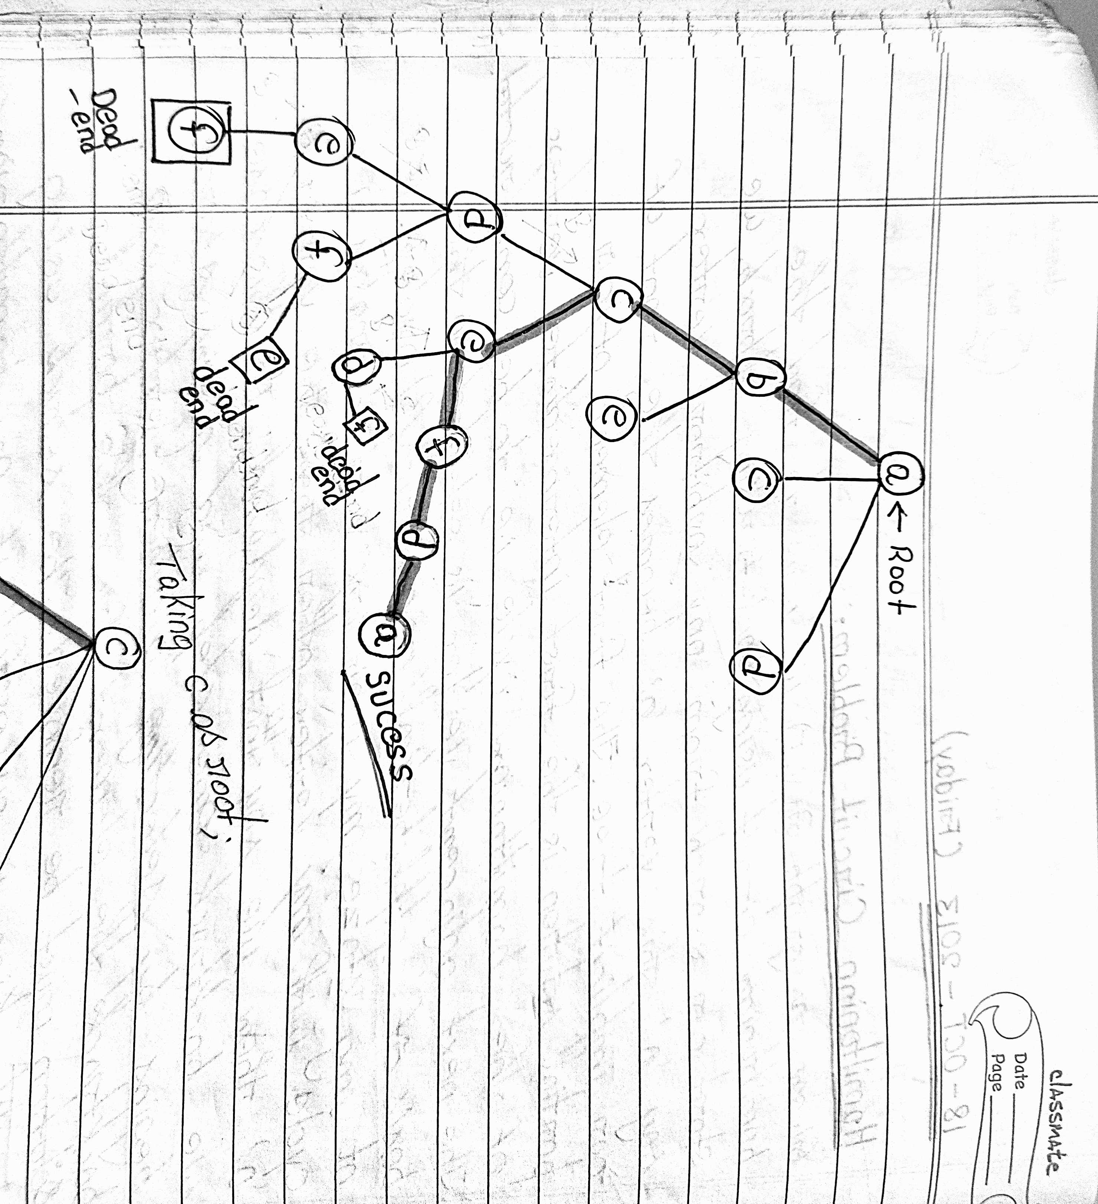
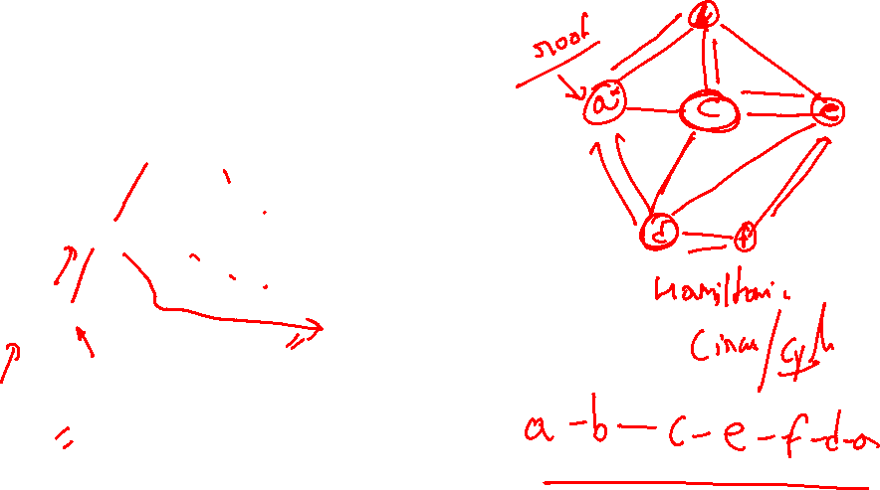

Slide 25
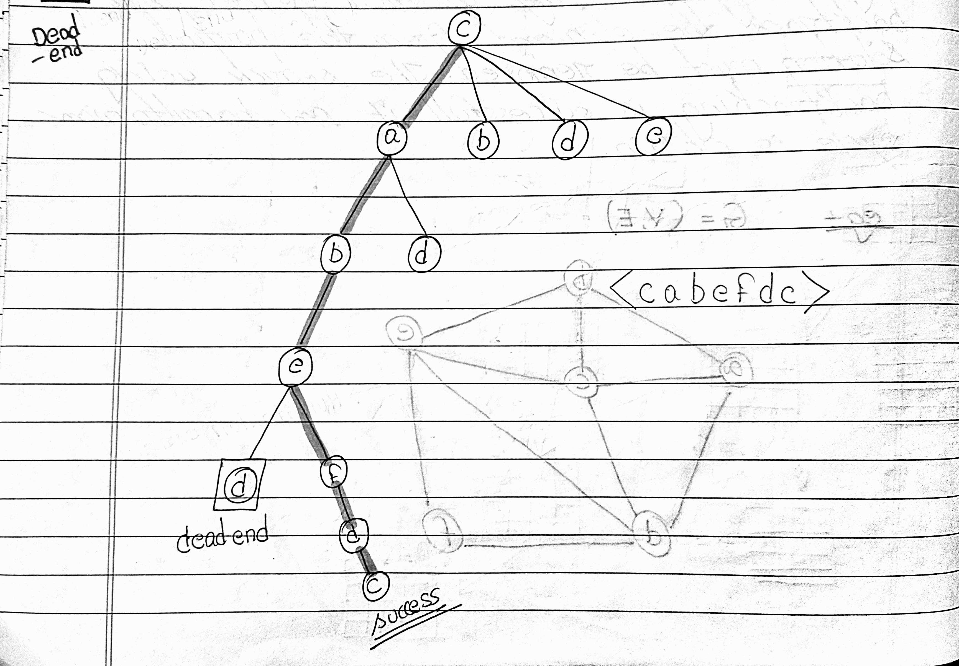

Slide 26
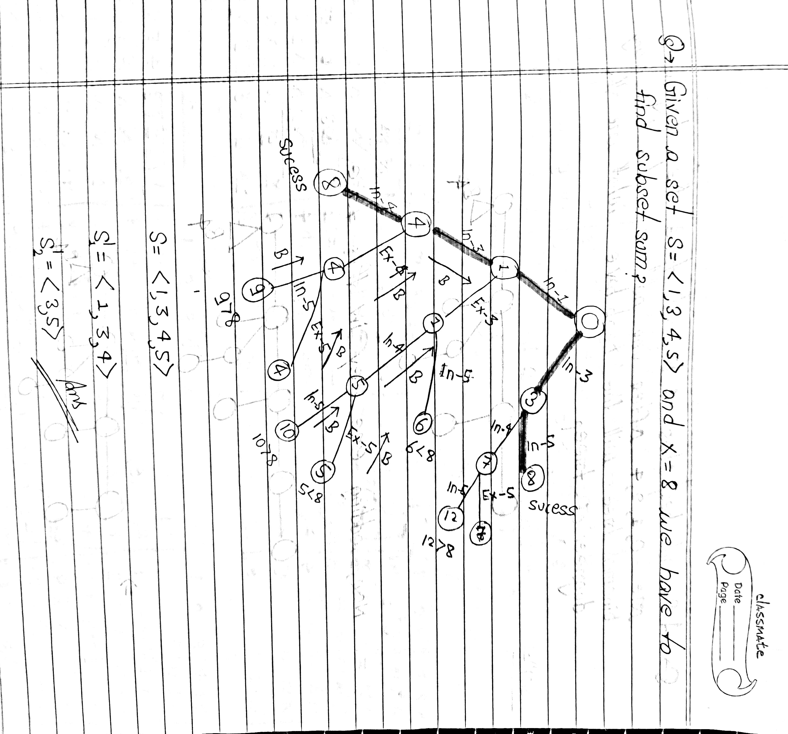
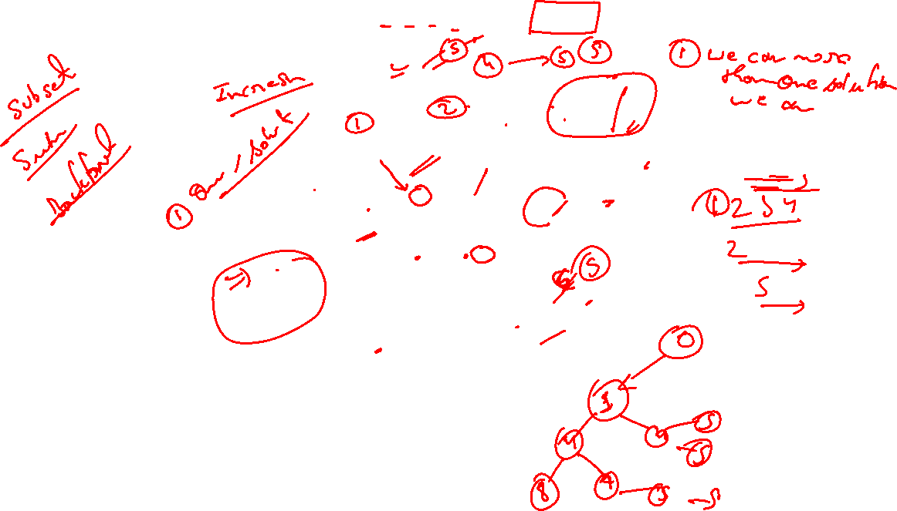

Slide 27
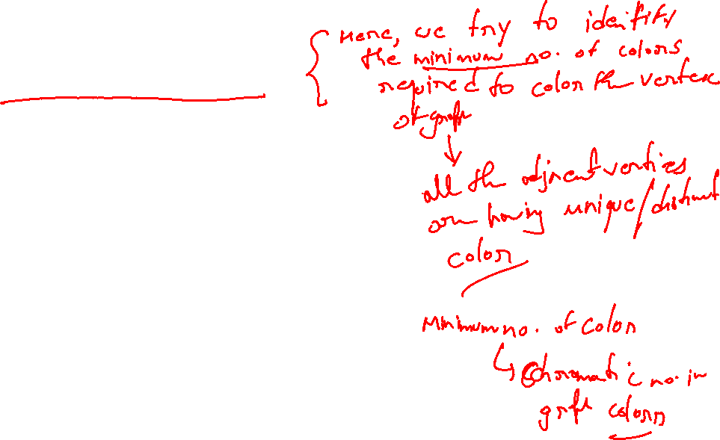
Coloring Graphs
This handout:
Coloring maps and graphs
Chromatic number
Applications of graph coloring

Slide 28


Coloring maps
Color a map such that two regions with a common border are assigned different colors.
Each map can be represented by a graph:
Each region of the map is represented by a vertex;
Edges connect two vertices if the regions represented by these vertices have a common border.
The resulting graph is called the dual graph of the map.

Slide 29
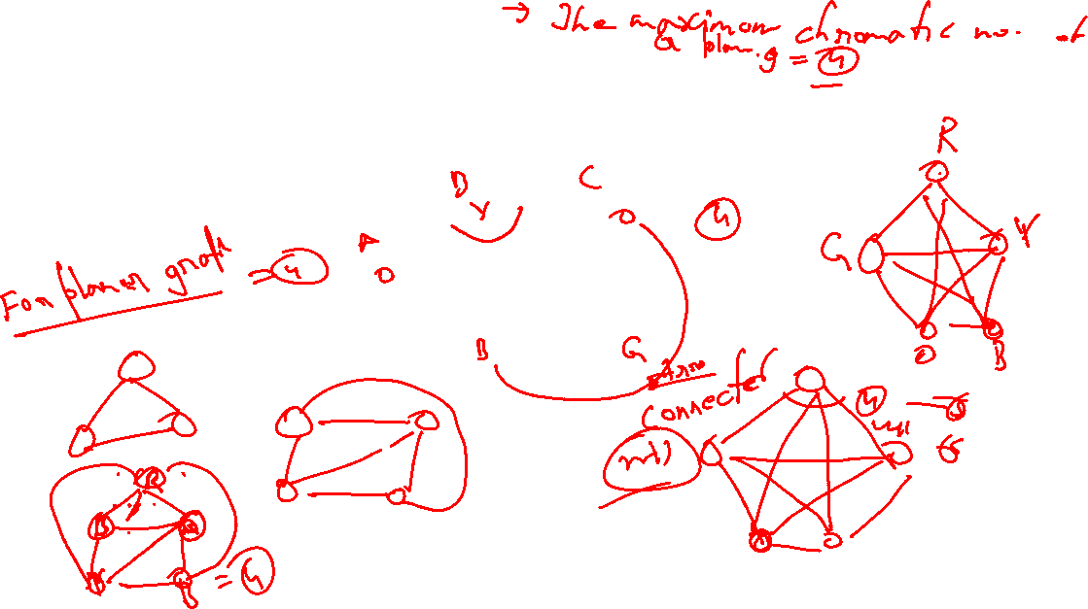
Coloring Graphs
Definition: A graph has been colored if a color has been assigned to each vertex in such a way that adjacent vertices have different colors.
Definition: The chromatic number of a graph is the smallest number of colors with which it can be colored.
In the example above, the chromatic number is 4.

Slide 30
Coloring Planar Graphs
Definition: A graph is planar if it can be drawn in a plane without edge-crossings.
The four color theorem: For every planar graph, the chromatic number is ≤ 4.
Was posed as a conjecture in the 1850s. Finally proved in 1976 (Appel and Haken) by the aid of computers.

Slide 31
An application of graph coloring in scheduling
Twelve faculty members in a mathematics department serve on the following committees:
Undergraduate education: Sineman, Limitson, Axiomus, Functionini
Graduate Education: Graphian, Vectorades, Functionini, Infinitescu
Colloquium: Lemmeau, Randomov, Proofizaki
Library: Van Sum, Sineman, Lemmeau
Staffing: Graphian, Randomov, Vectorades, Limitson
Promotion: Vectorades, Van Sum, Parabolton
The committees must all meet during the first week of classes, but there are only three time slots available. Find a schedule that will allow all faculty members to attend the meetings of all committees on which they serve.

Slide 32
An application of graph coloring in exam scheduling
Suppose that in a particular quarter there are students taking each of the following combinations of courses:
Math, English, Biology, Chemistry
Math, English, Computer Science, Geography
Biology, Psychology, Geography, Spanish
Biology, Computer Science, History, French
English, Psychology, Computer Science, History
Psychology, Chemistry, Computer Science, French
Psychology, Geography, History, Spanish
What is the minimum number of examination periods required for the exams in the ten courses specified so that students taking any of the given combinations of courses have no conflicts? Find a schedule that uses this minimum number of periods.

